Slide 1
Applied Data Science L6-7. Supervised Learning. Regression
Irina Mohorianu
Head of Bioinformatics/ Scientific Computing @CSCI

Slide 2
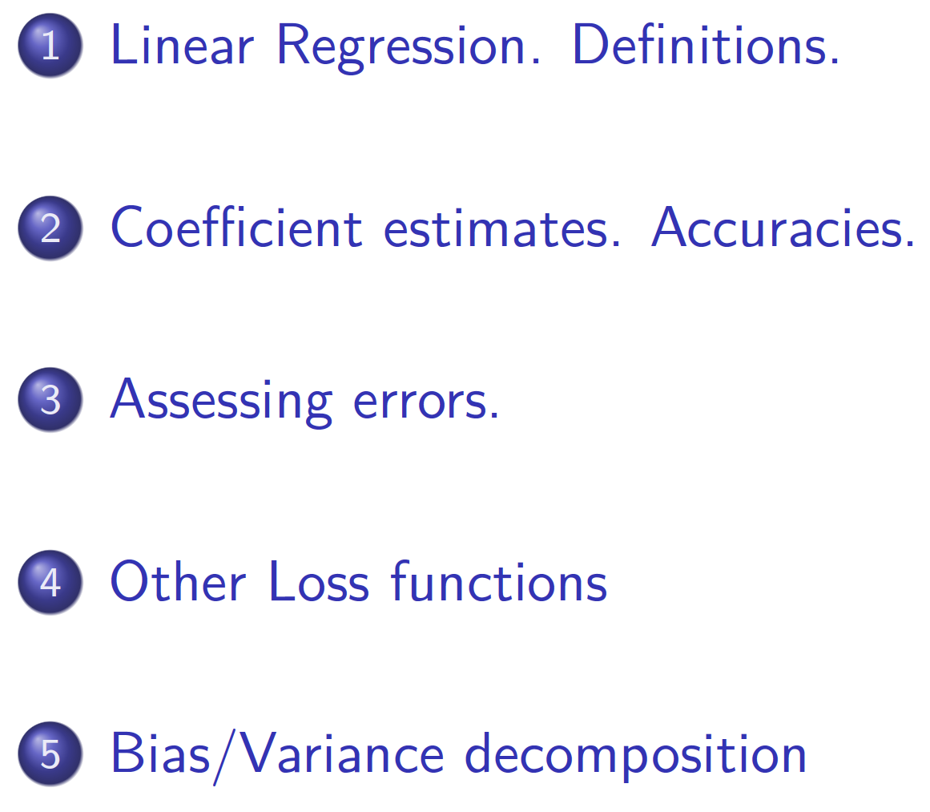
Outline [Regression 1]

Slide 3
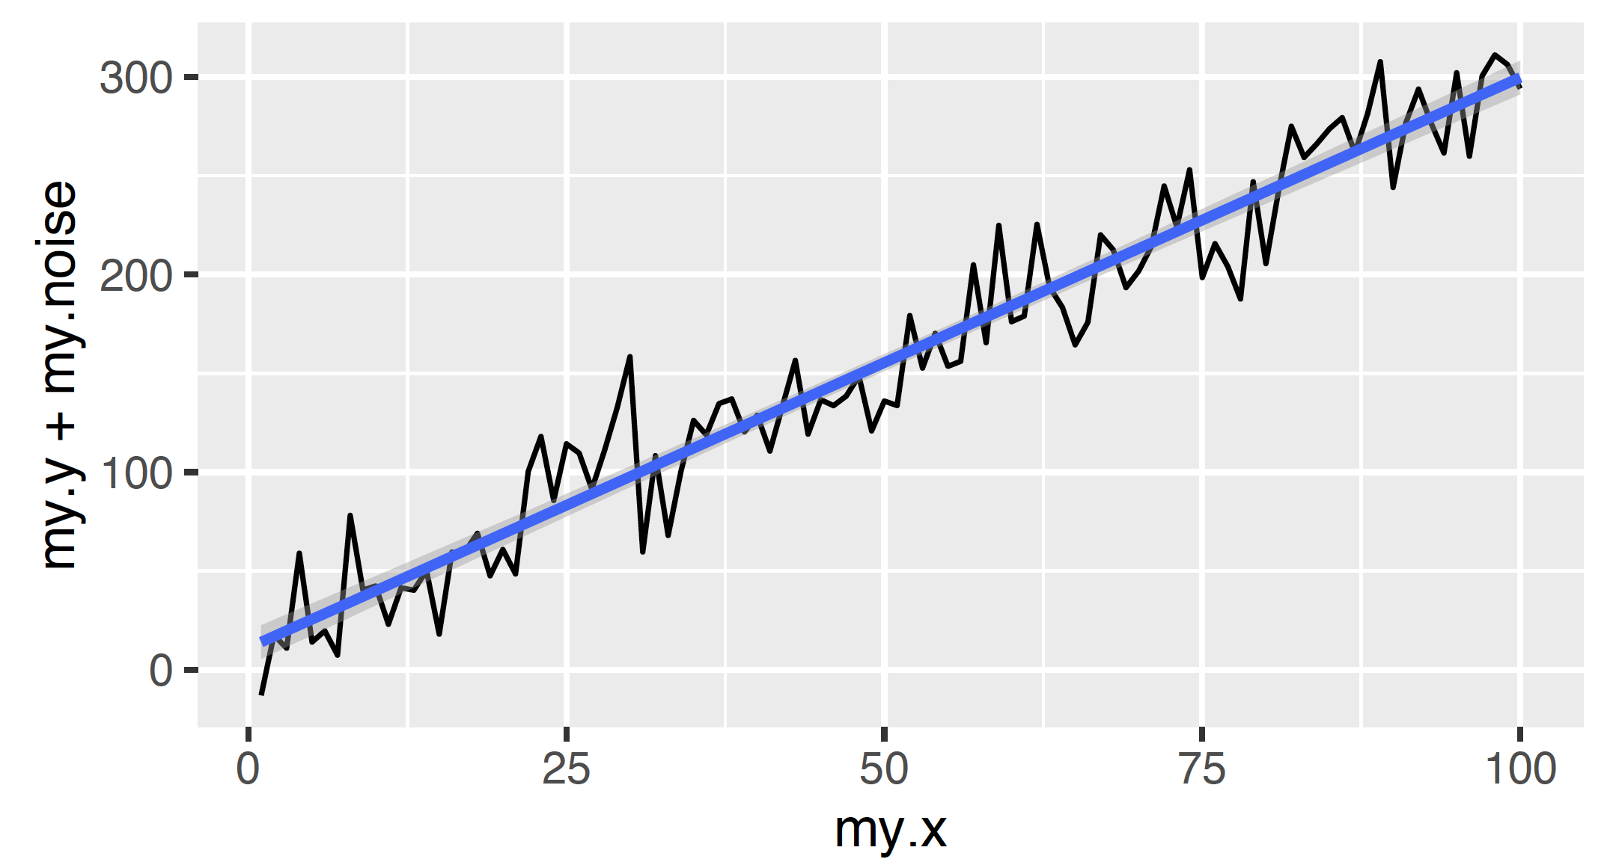
Linear regression. Definition

Slide 4
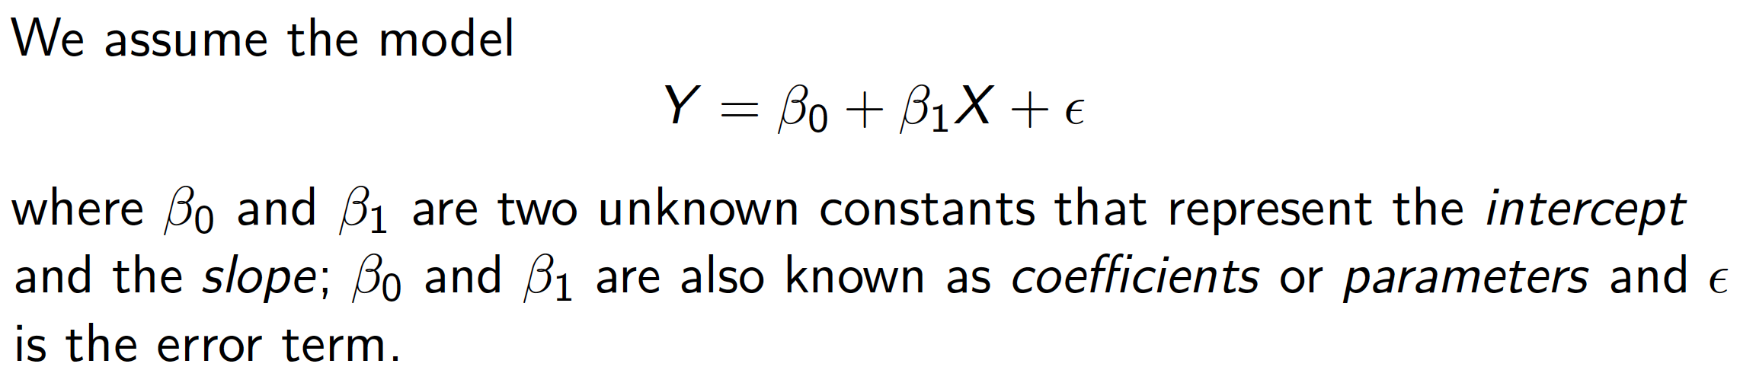
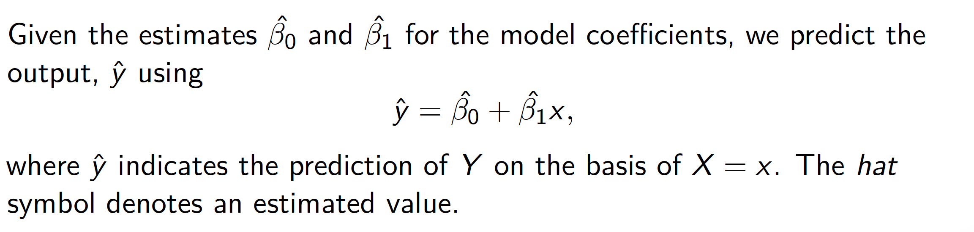
Linear regression. Definition

Slide 5
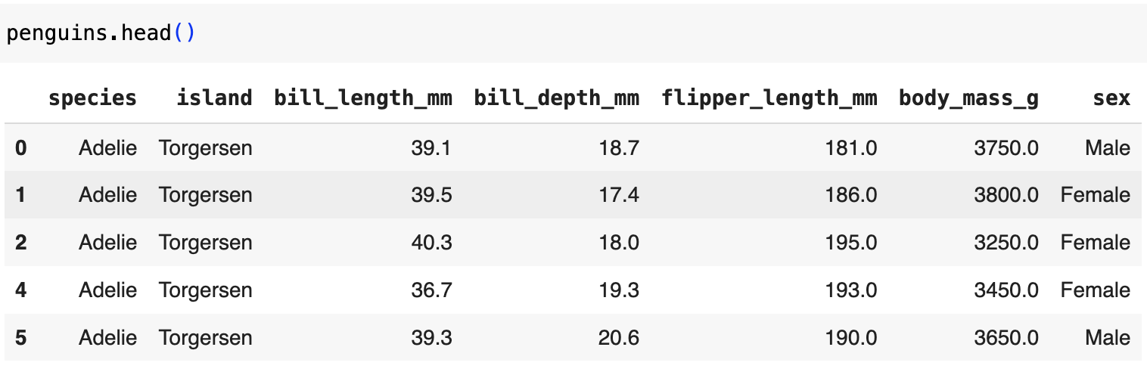
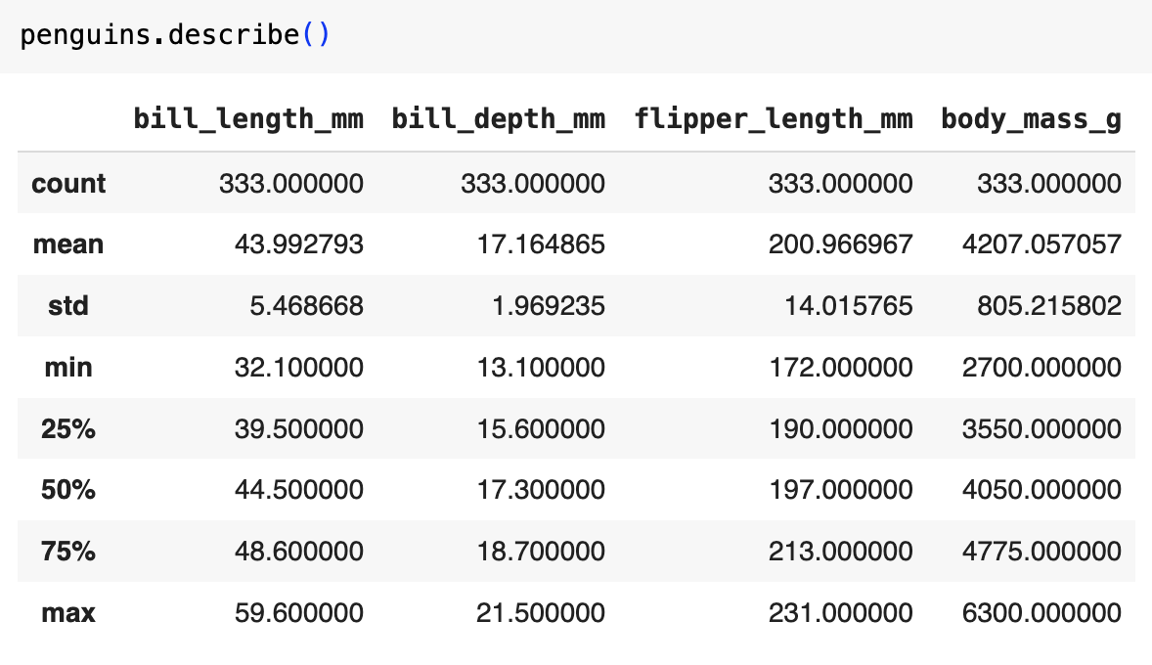
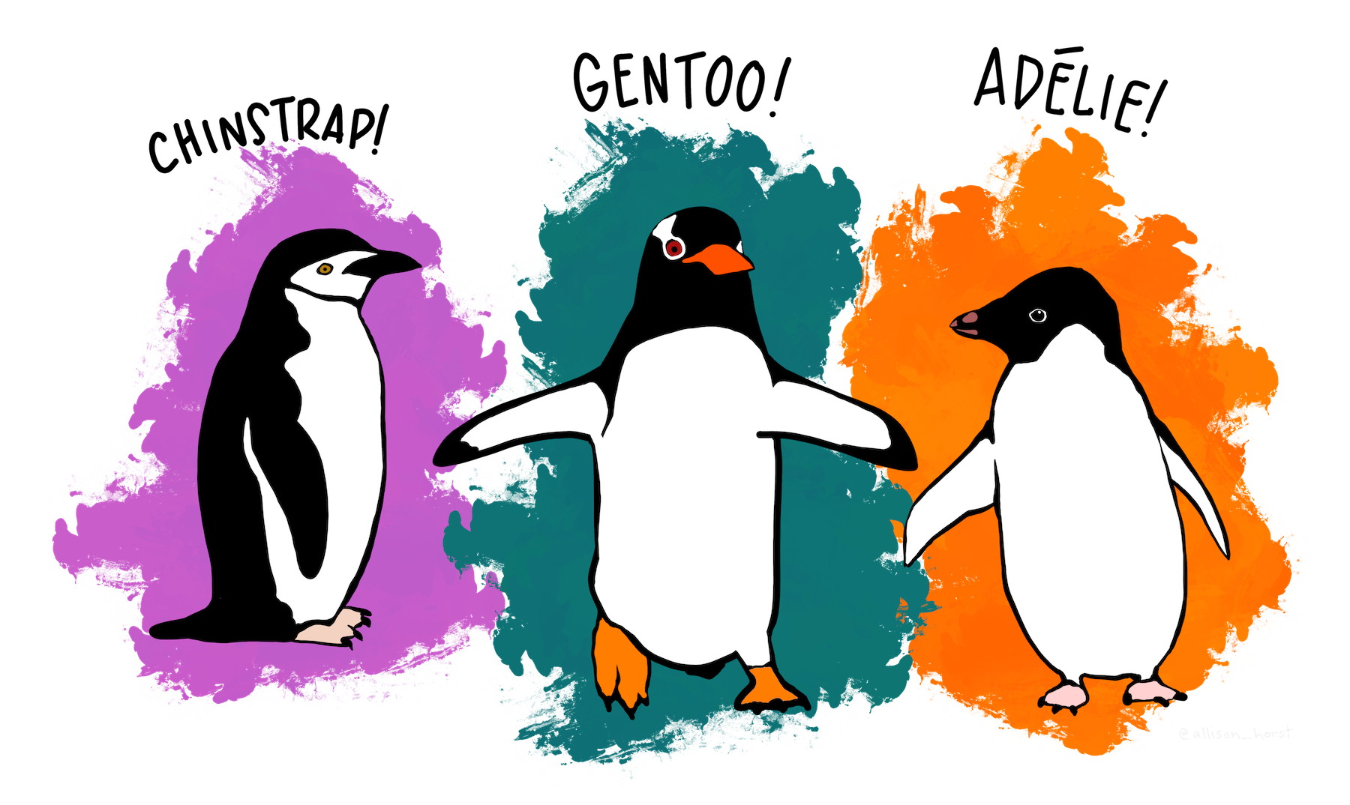
Linear regression. Definition

Slide 6
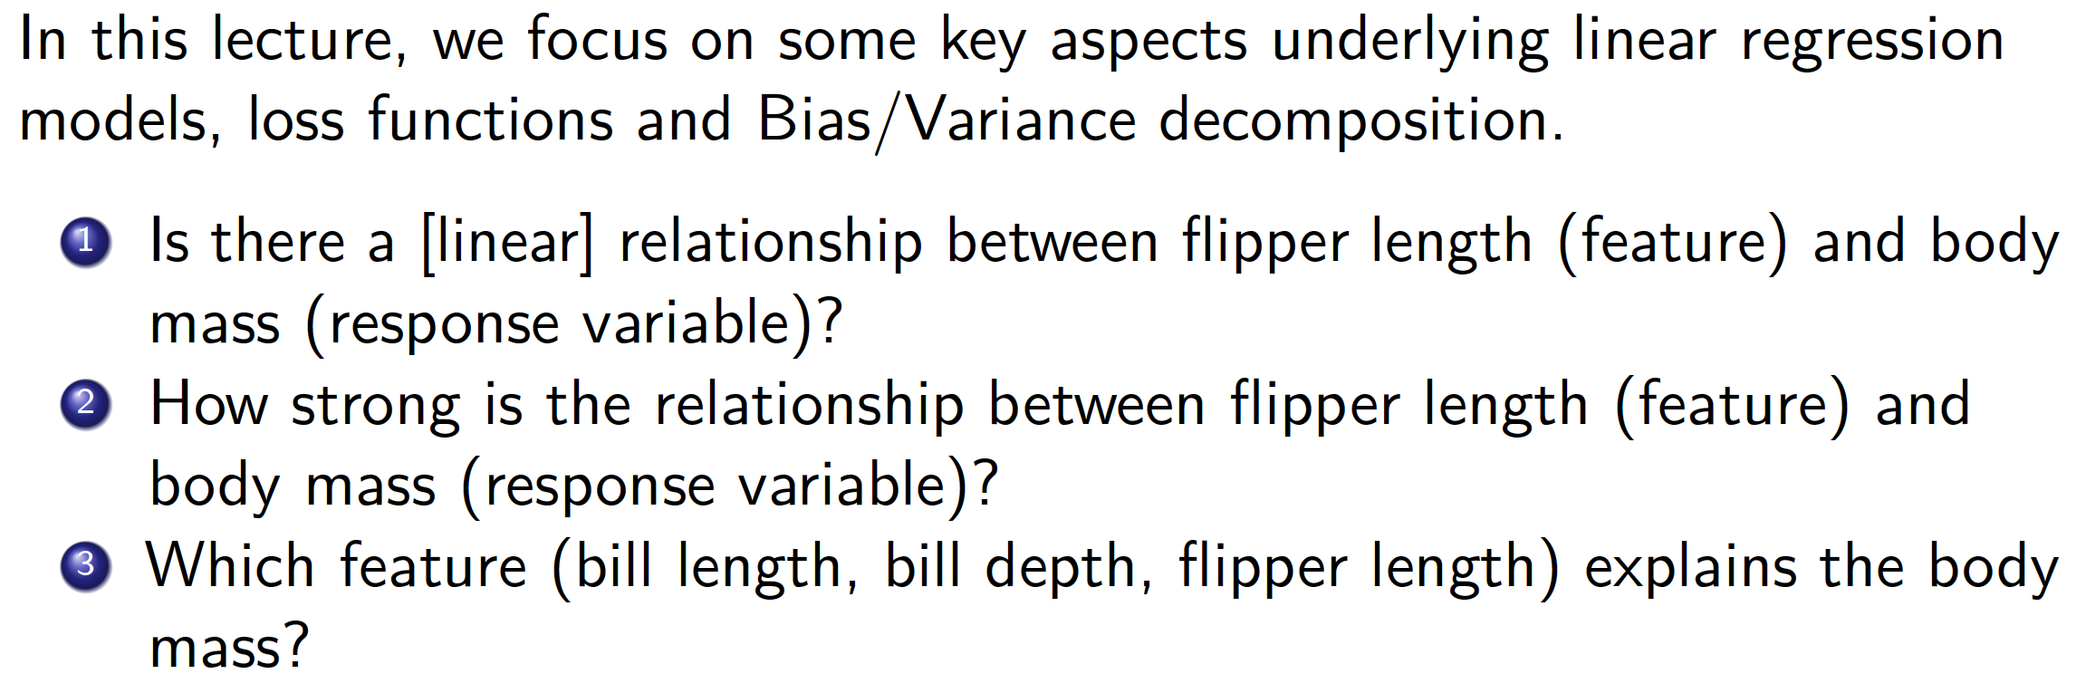
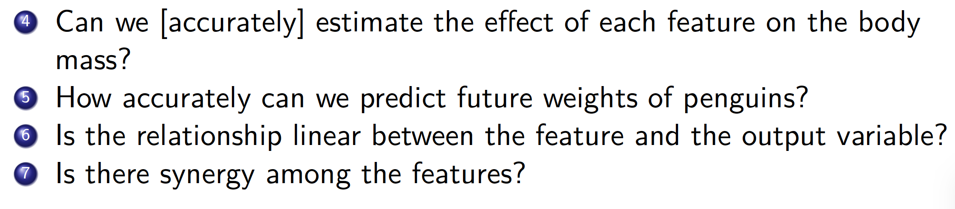
Linear regression. Why is regression useful?

Slide 7
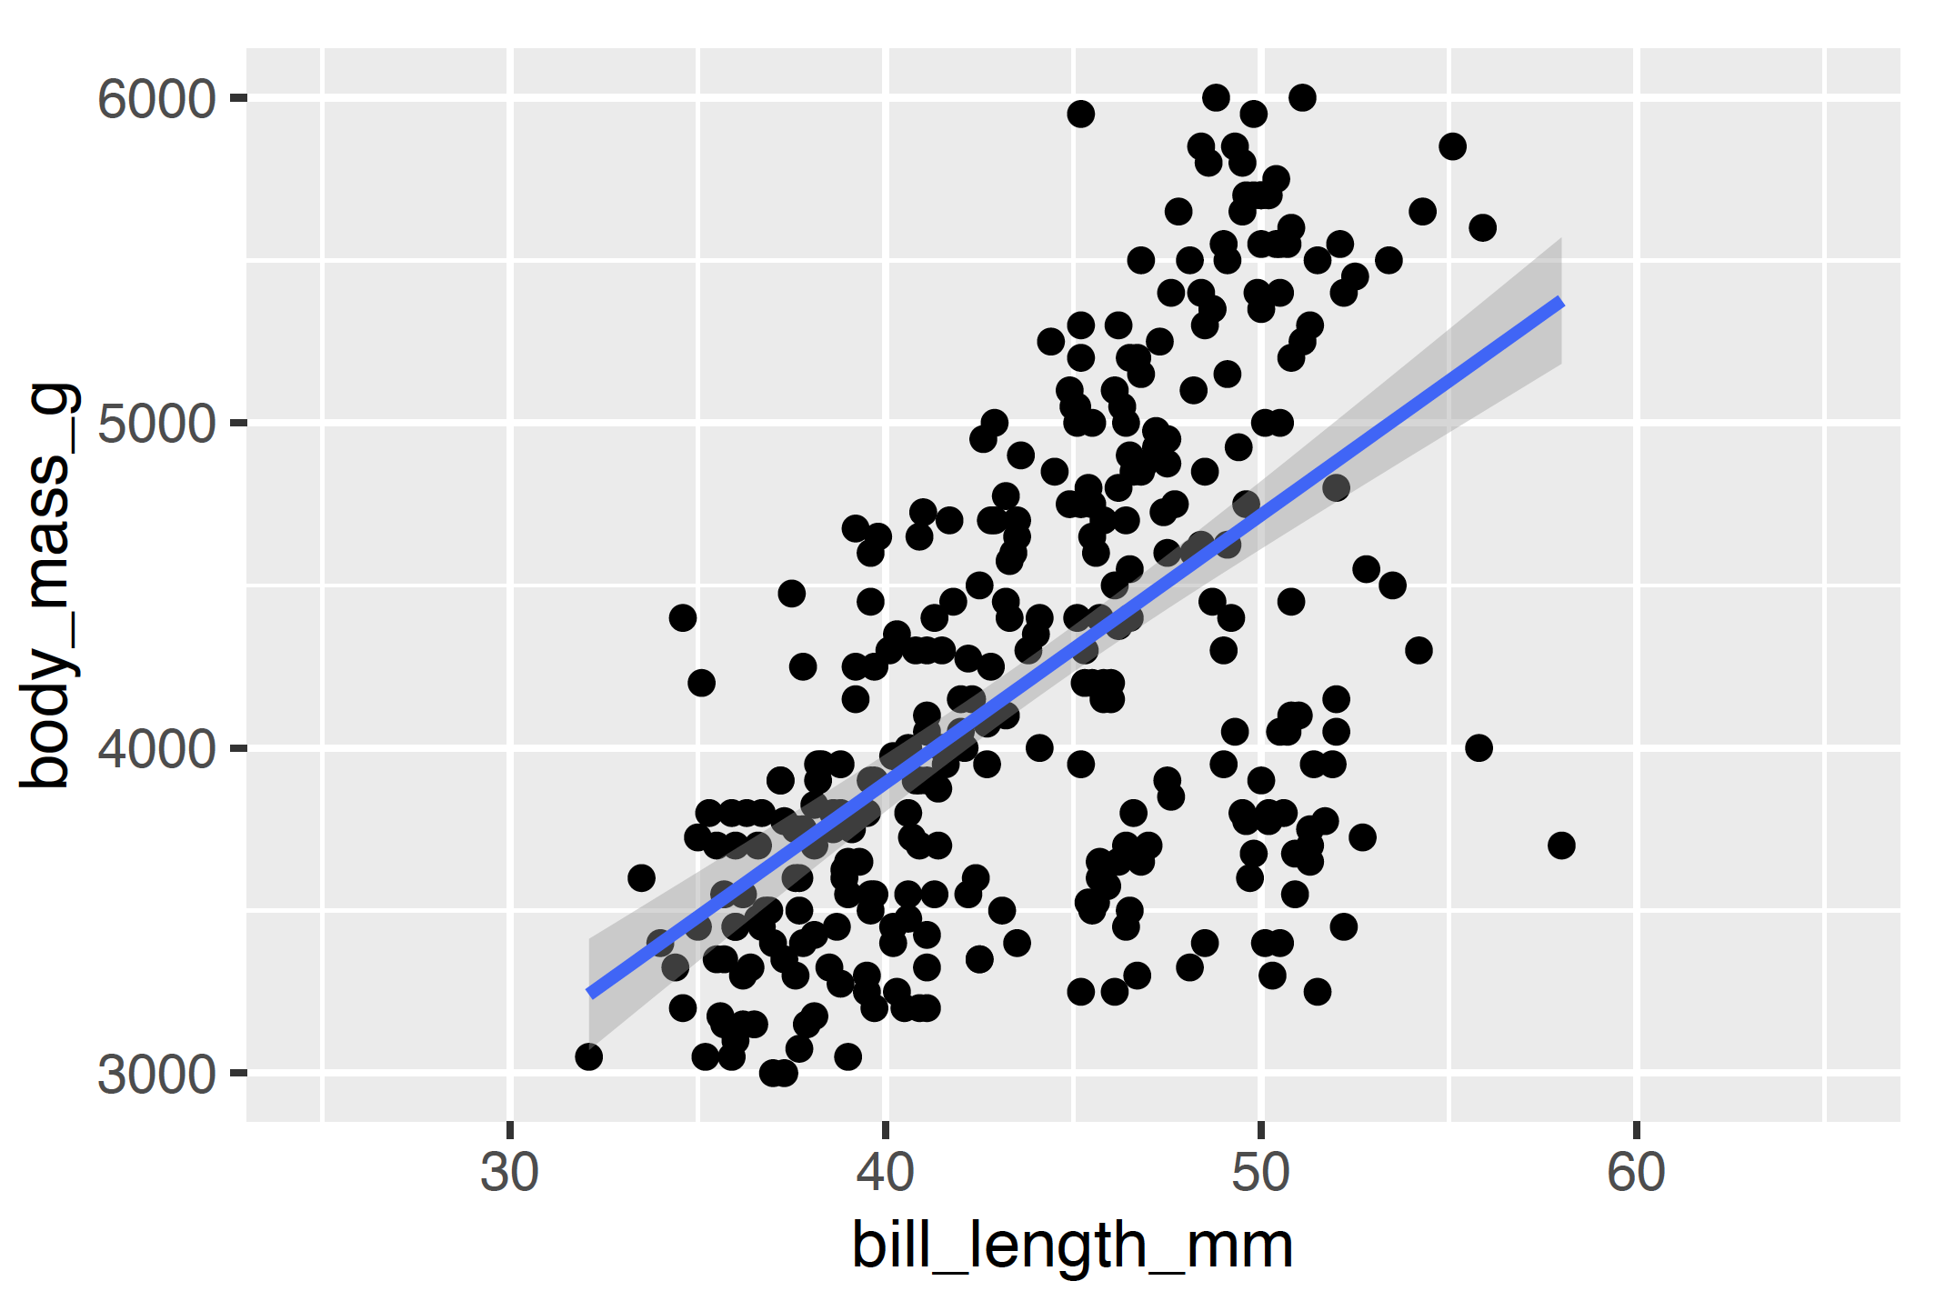
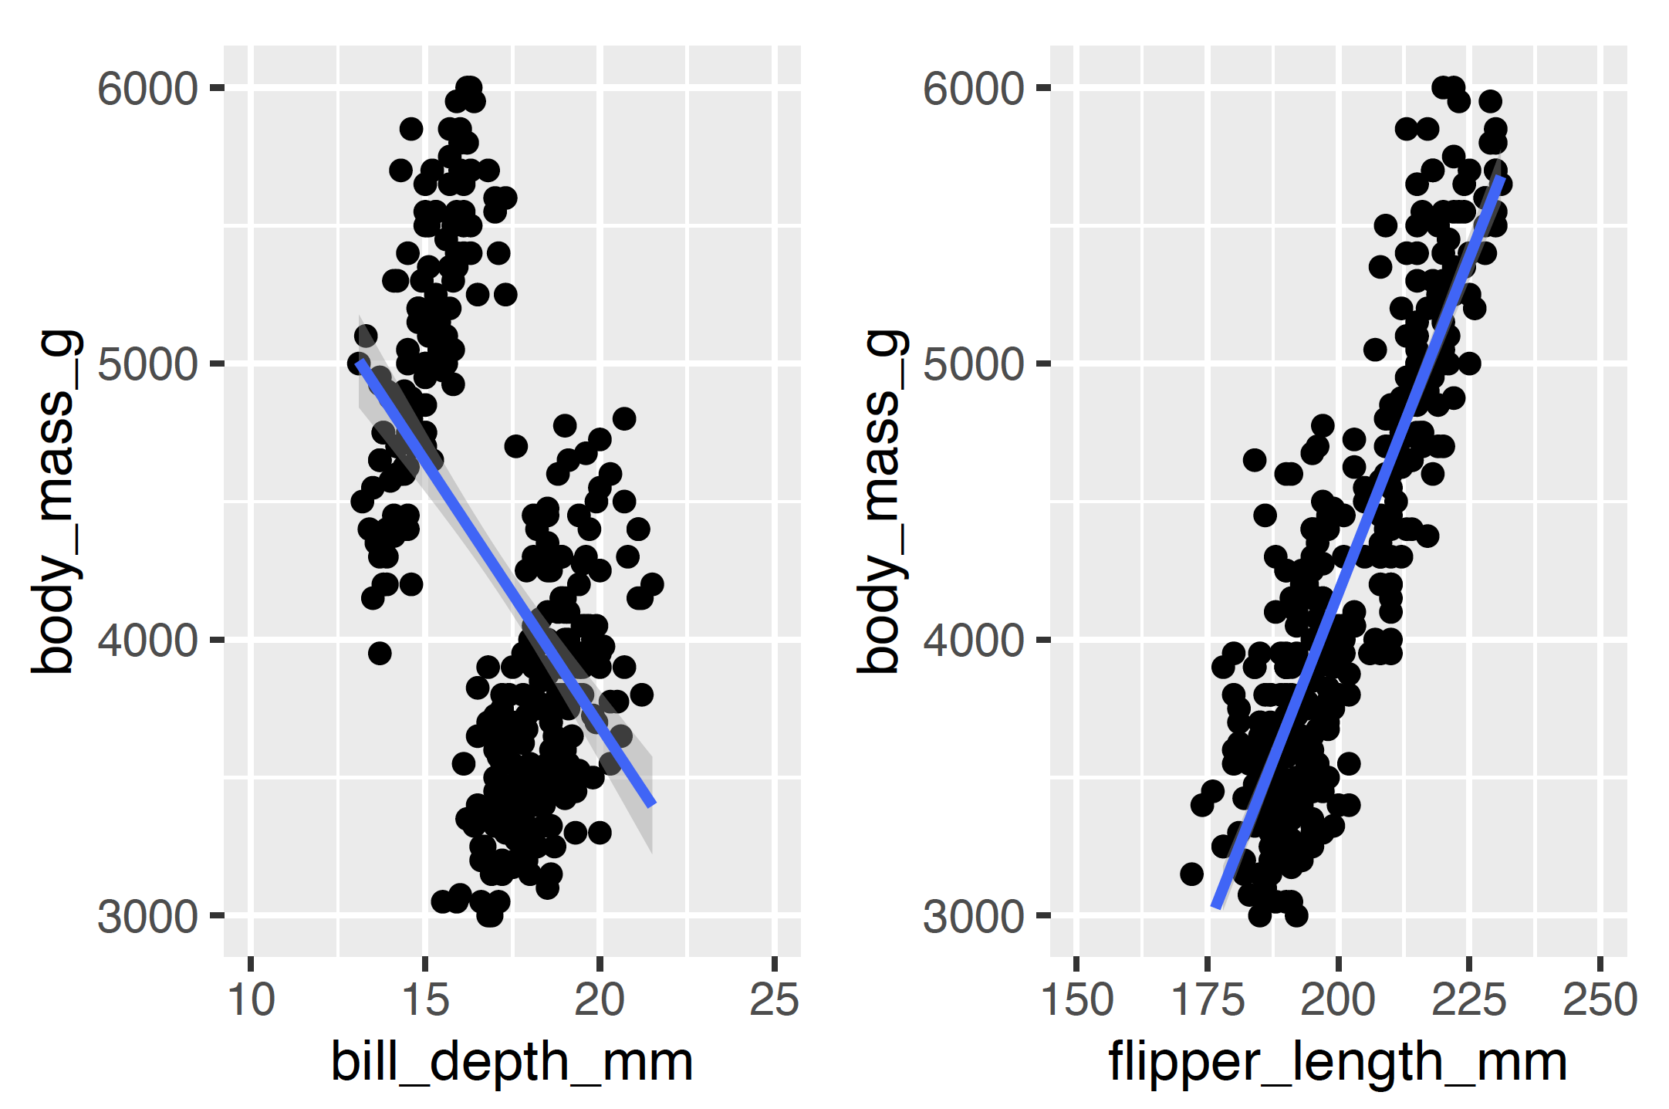
Linear regression. Dataset structure
Is this linear relation meaningful?

Slide 8
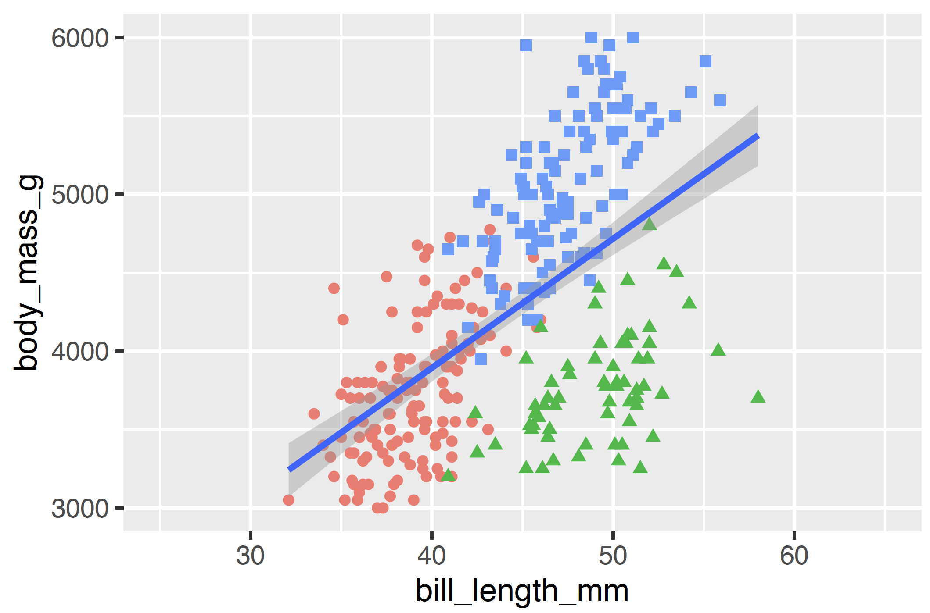
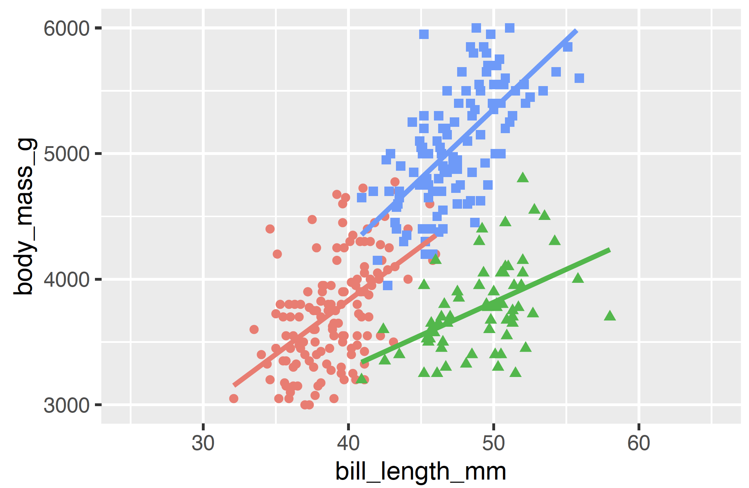
Linear regression. Dataset structure
By emphasising the 3 types of penguins, we note there is an underlying structure in the data.
The second panel shows that the coefficients per class are close, but not matched.

Slide 9
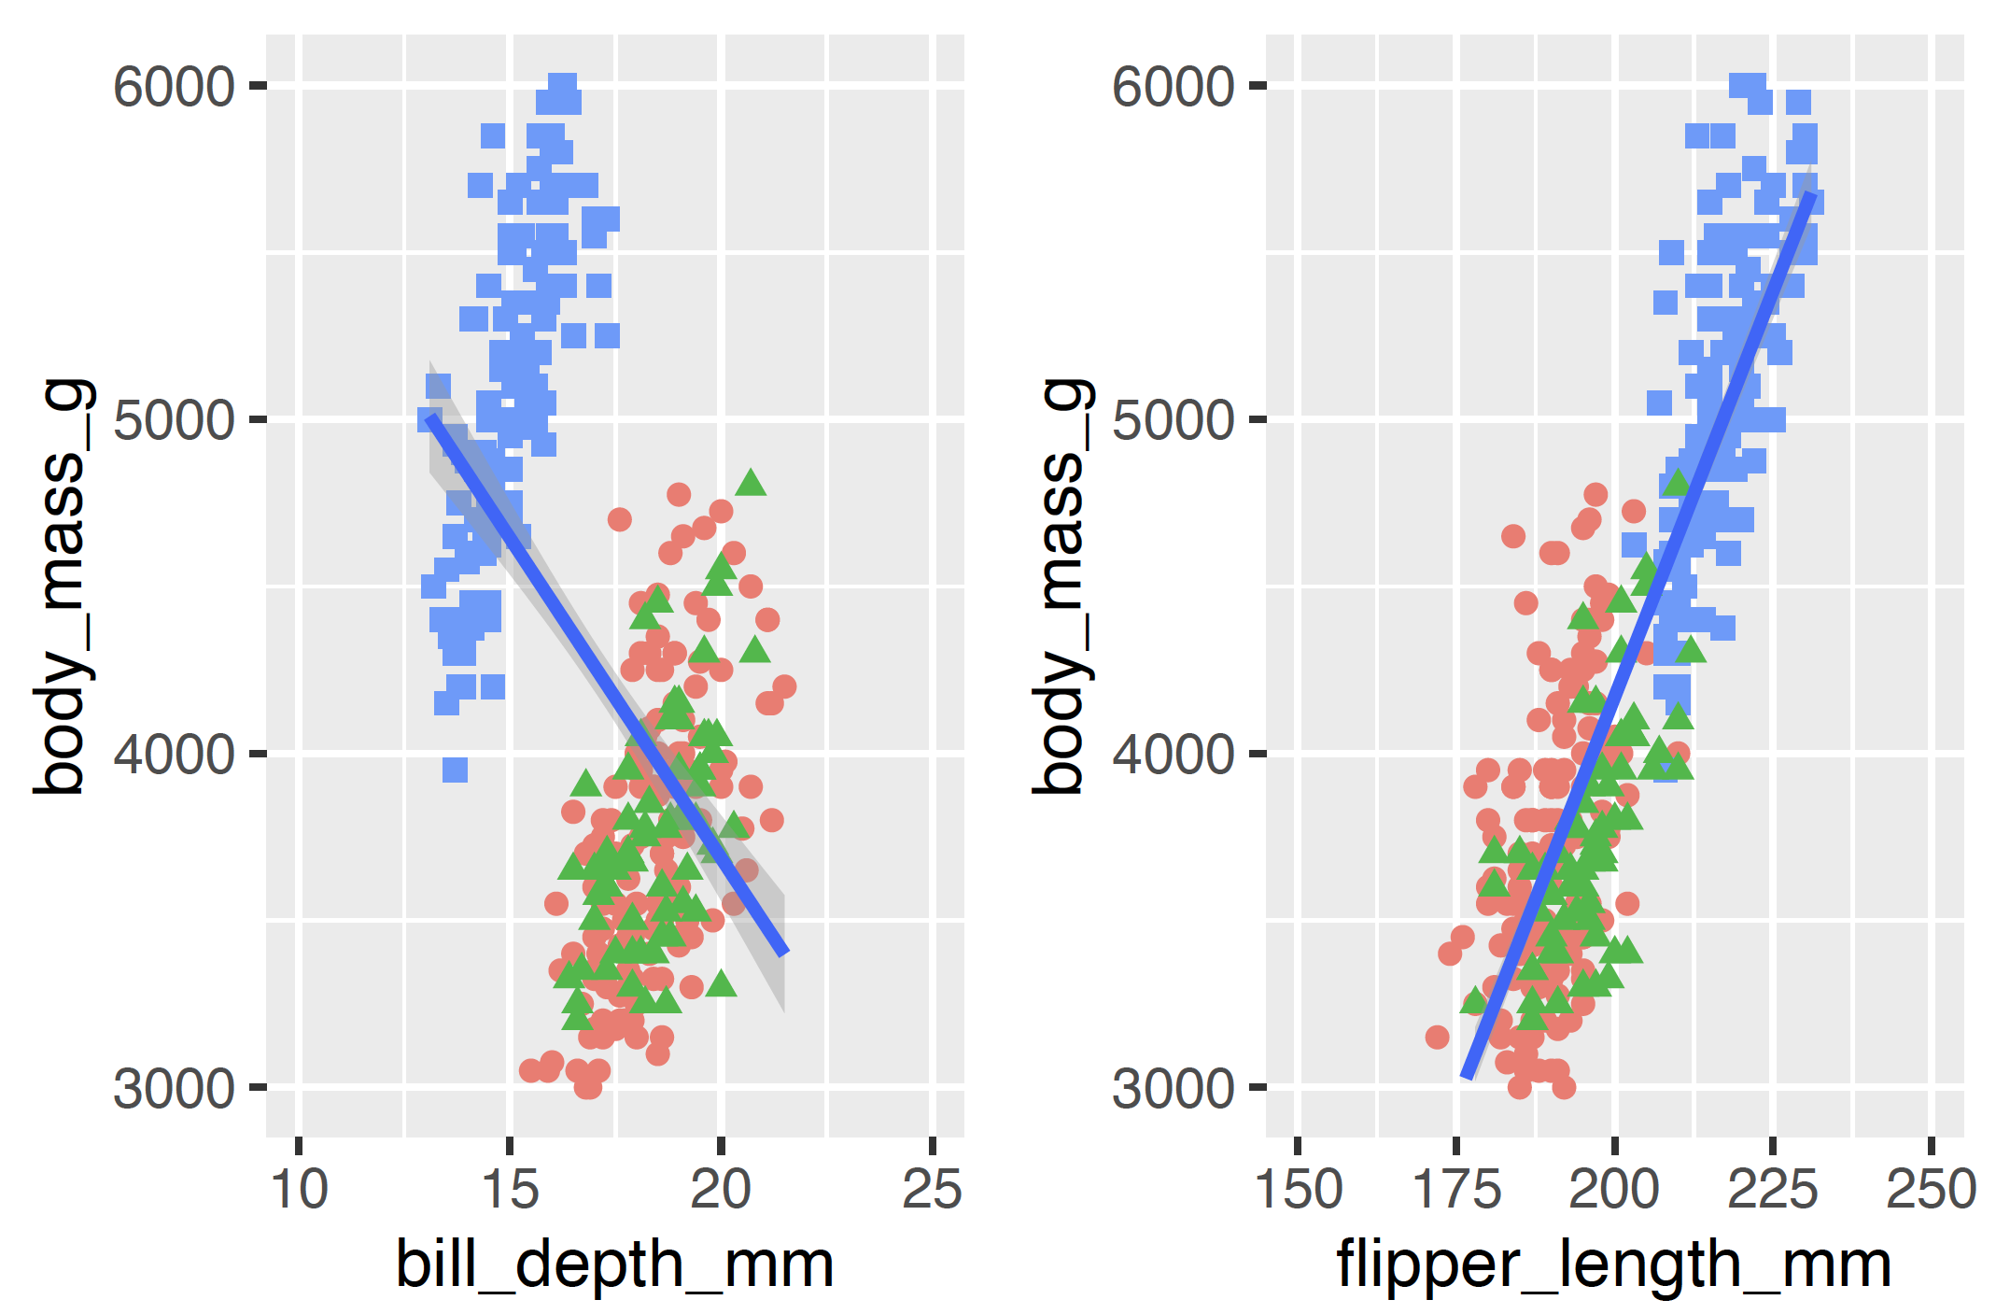
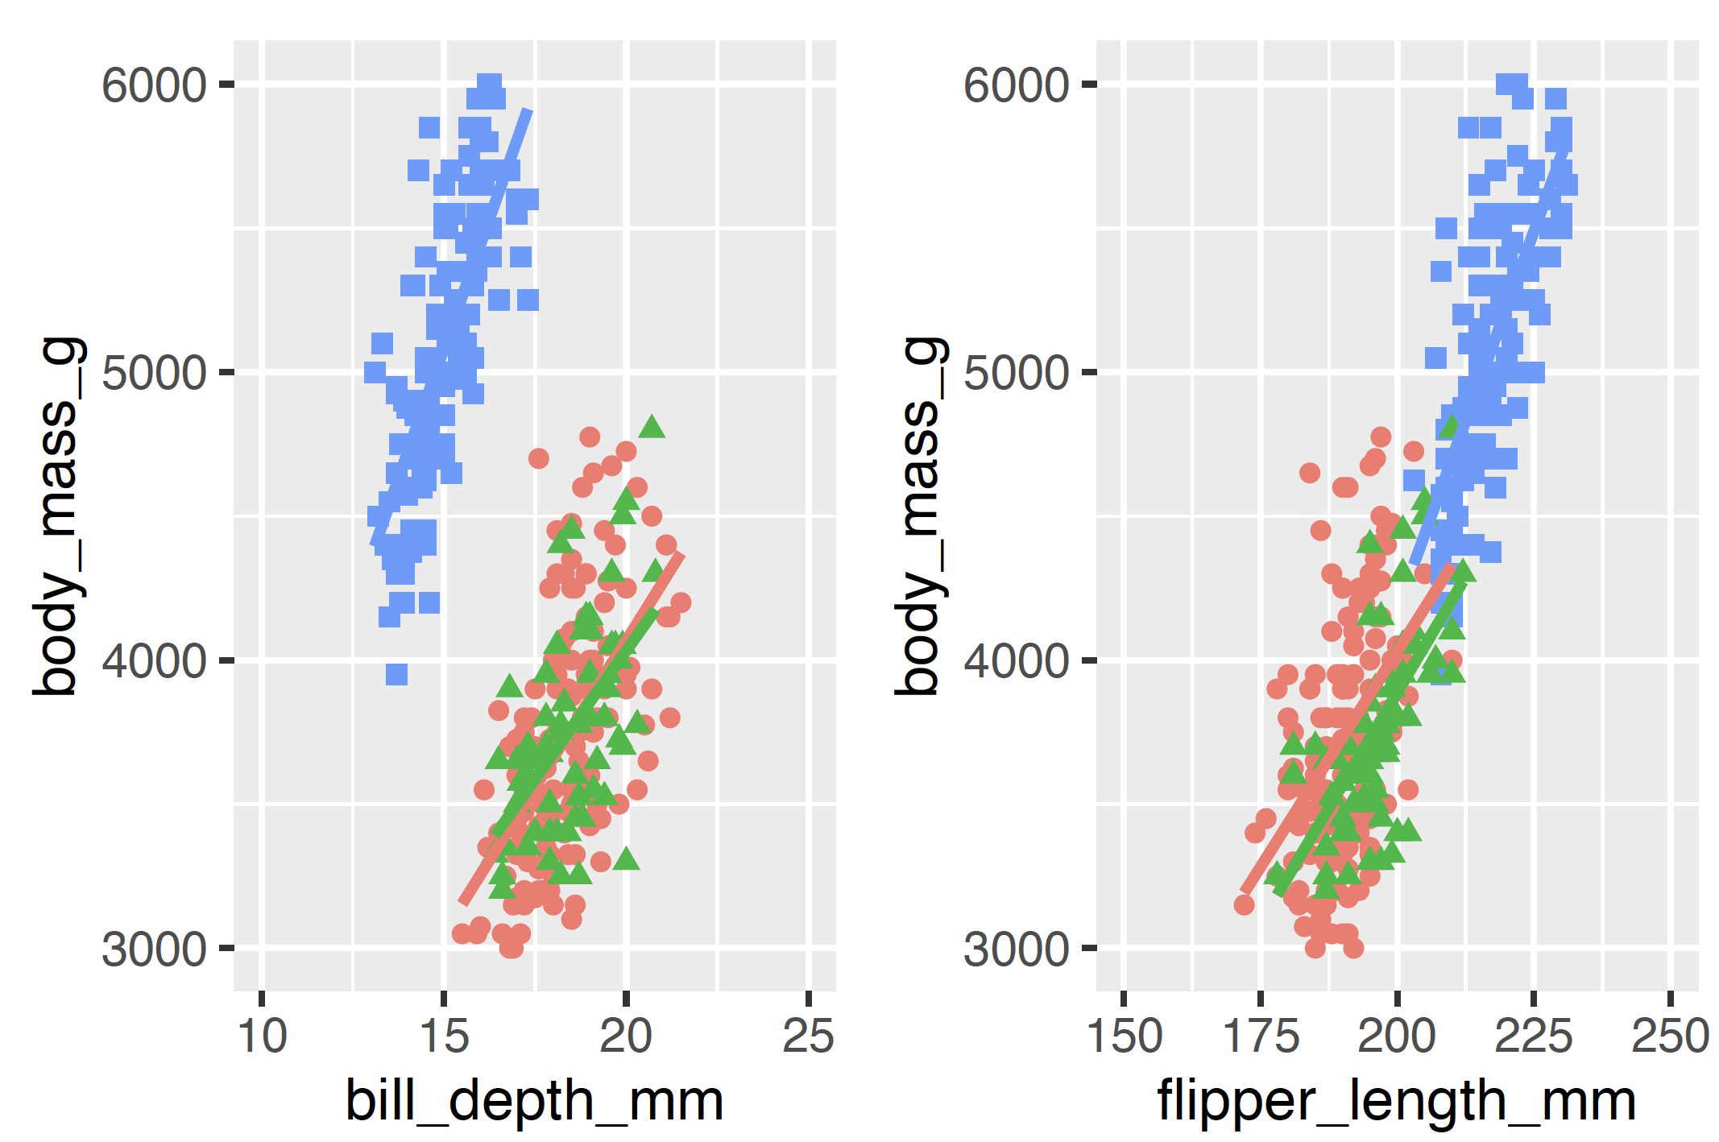
Linear regression. Dataset structure

Slide 10
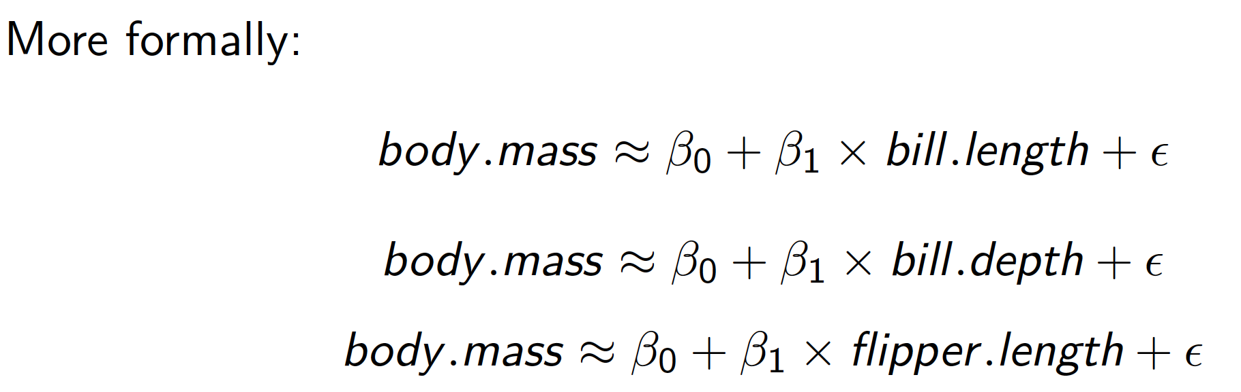
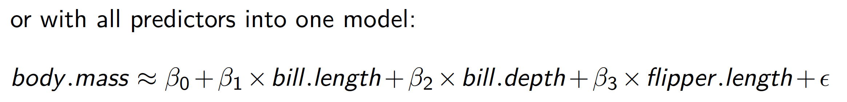
Linear regression. One feature model

Slide 11
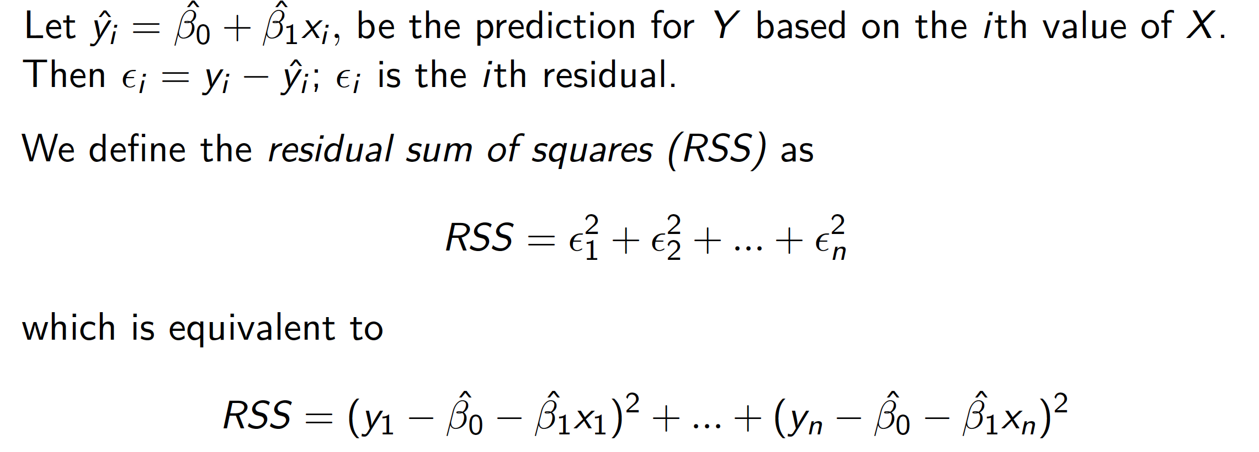
Linear regression. Residuals

Slide 12
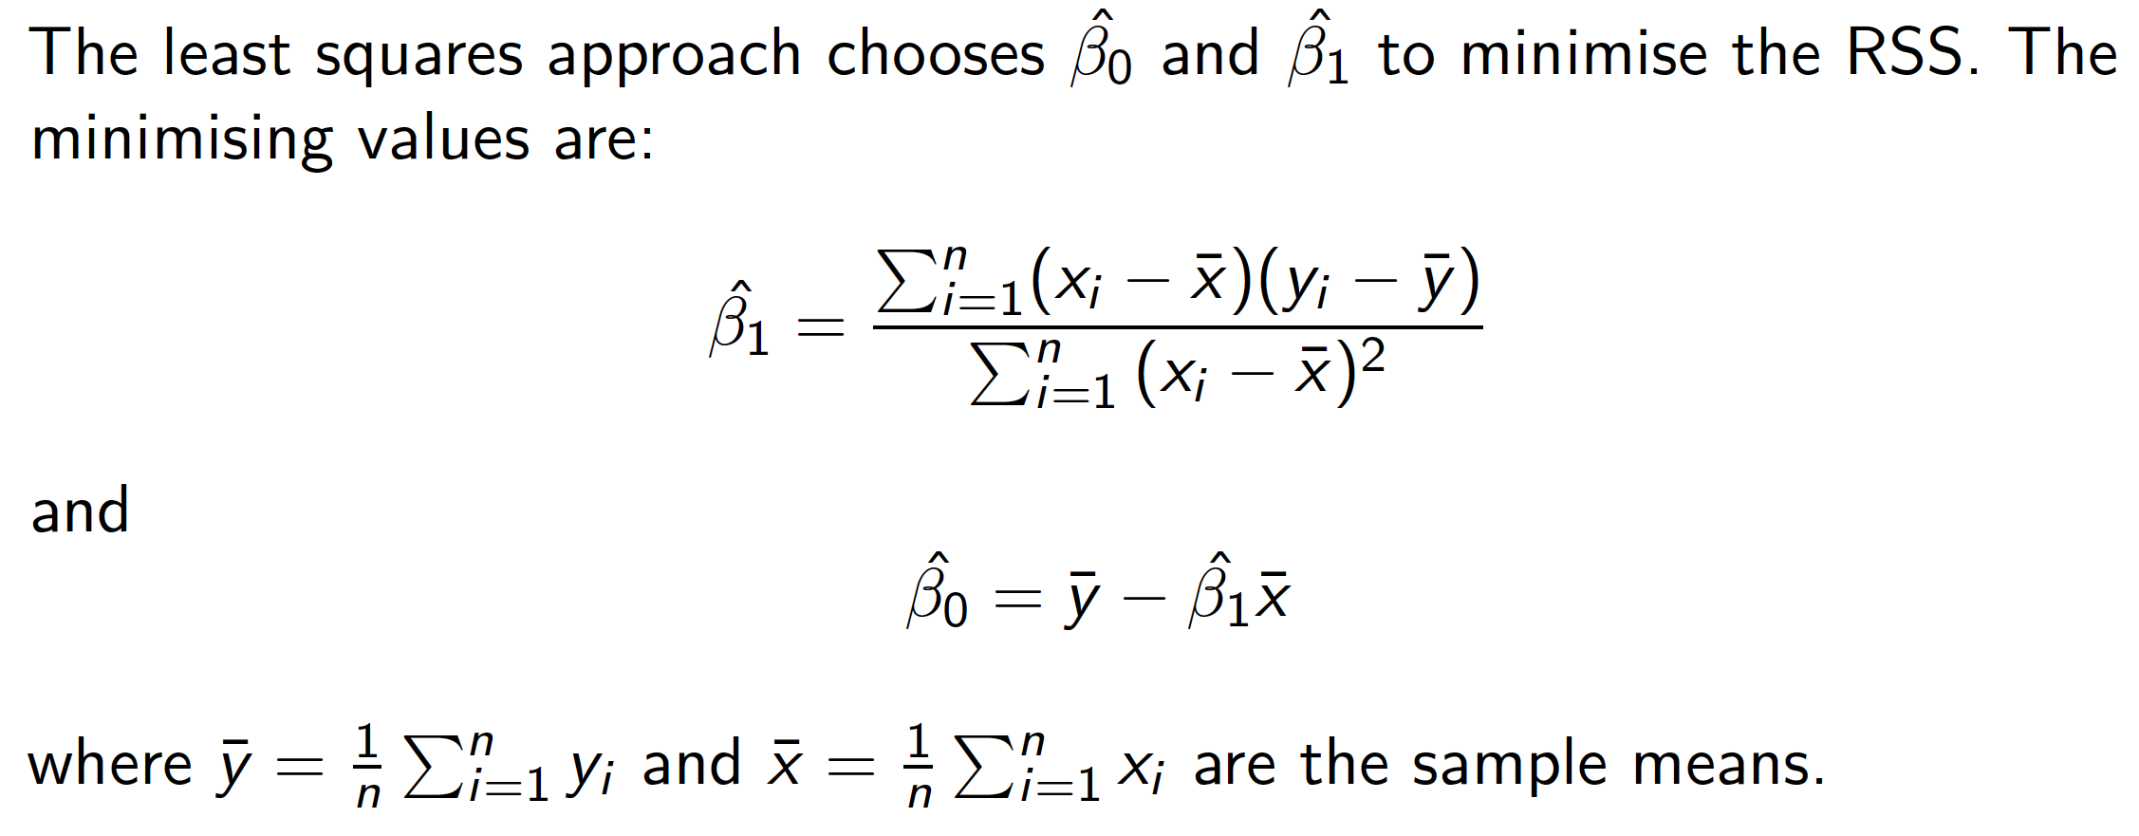
Linear regression. Estimates

Slide 13
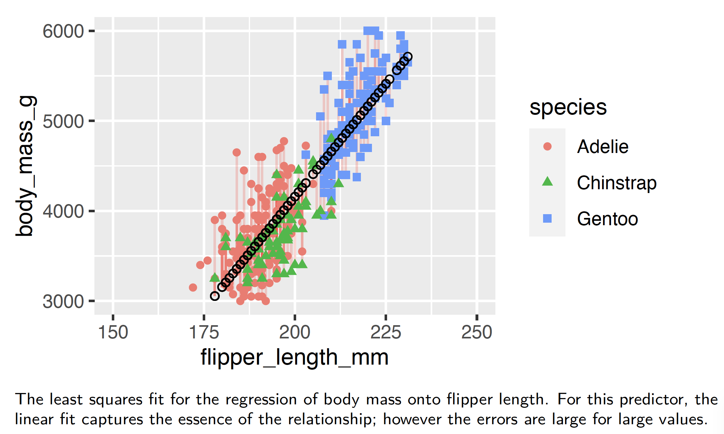
Linear regression. Flipper length

Slide 14
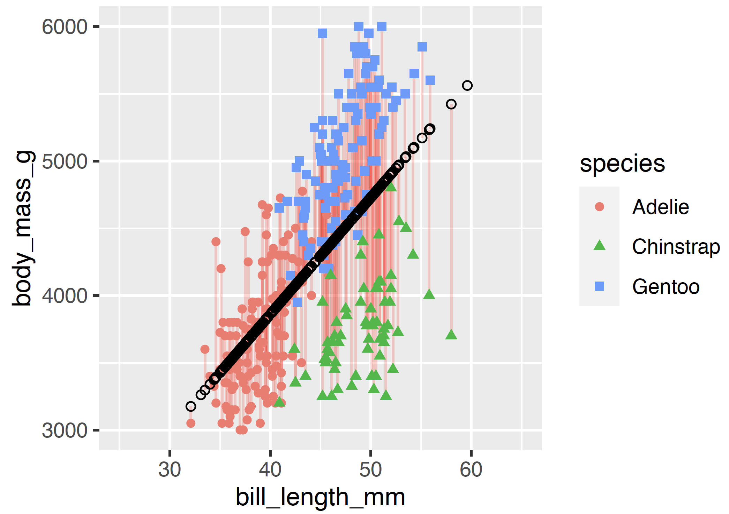
Linear regression. Bill length

Slide 15
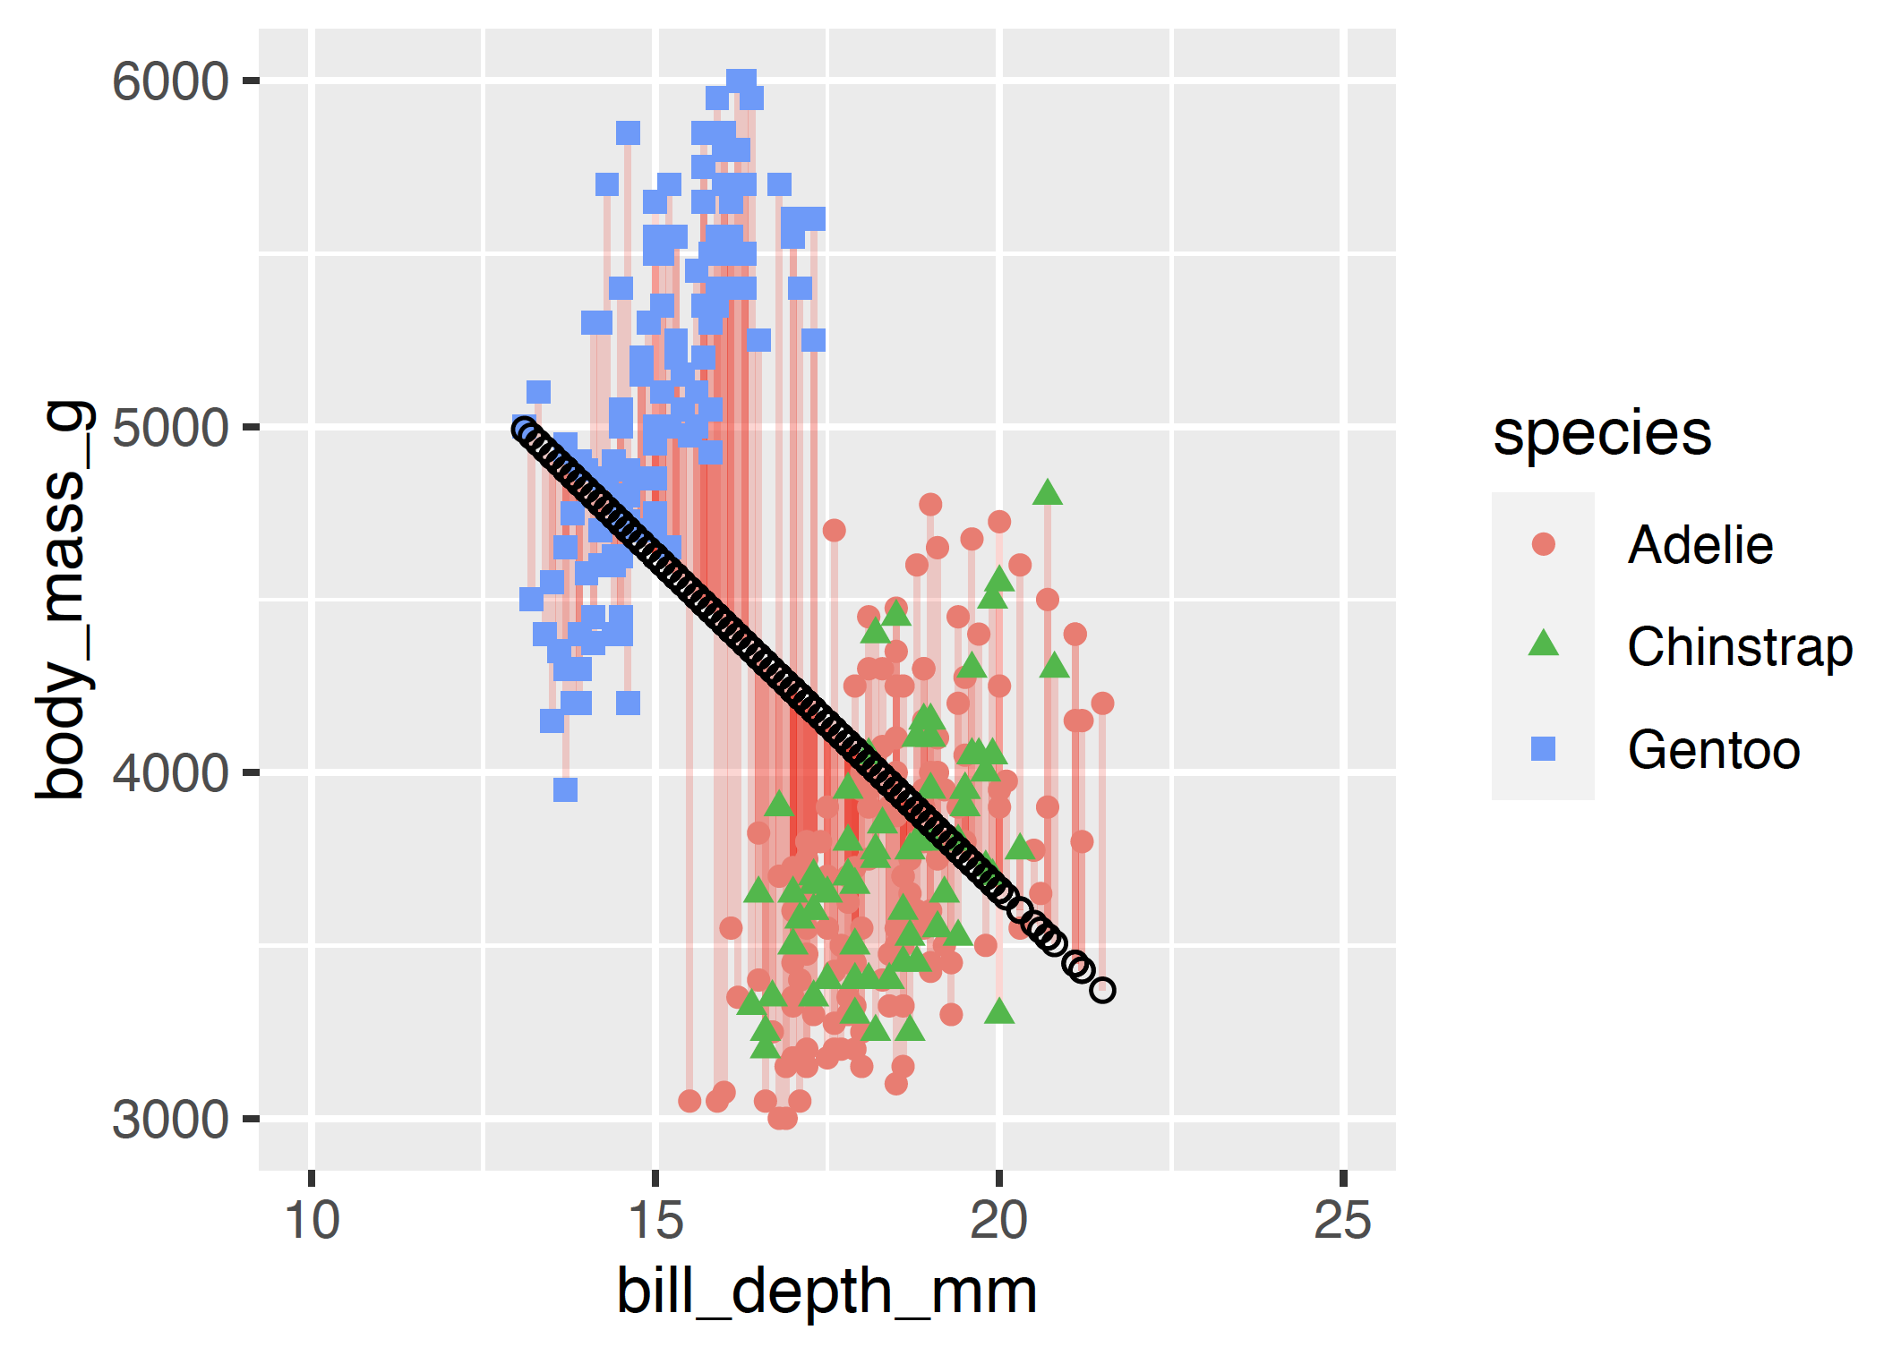
Linear regression. Bill depth

Slide 16
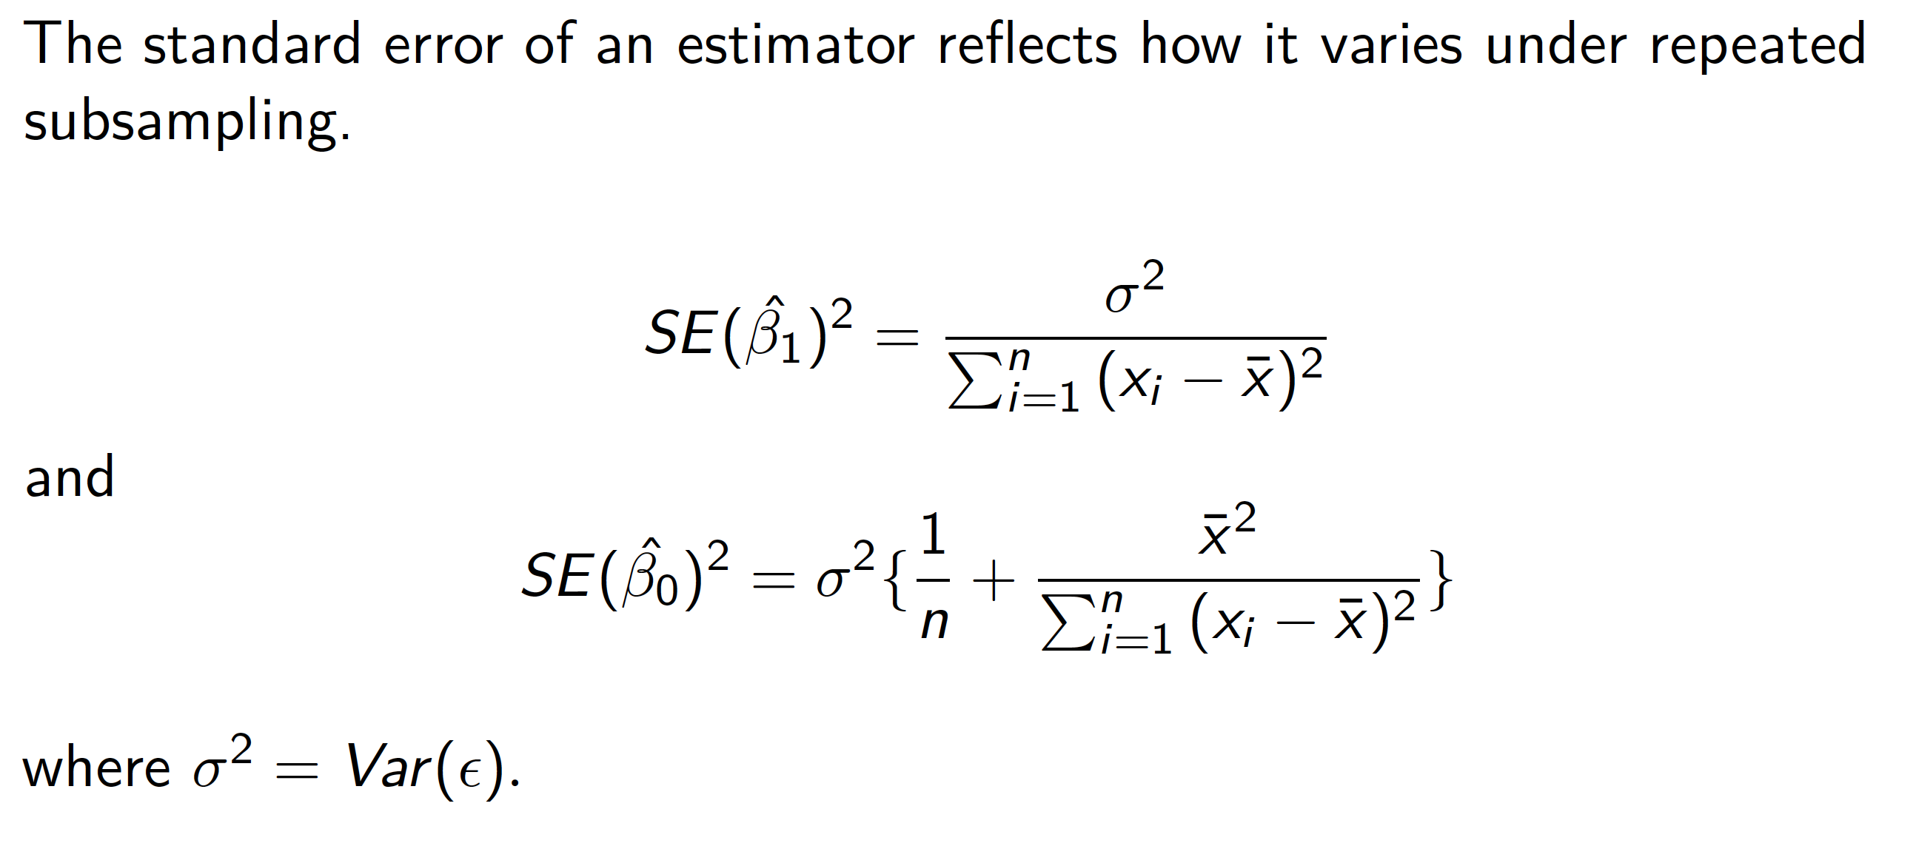
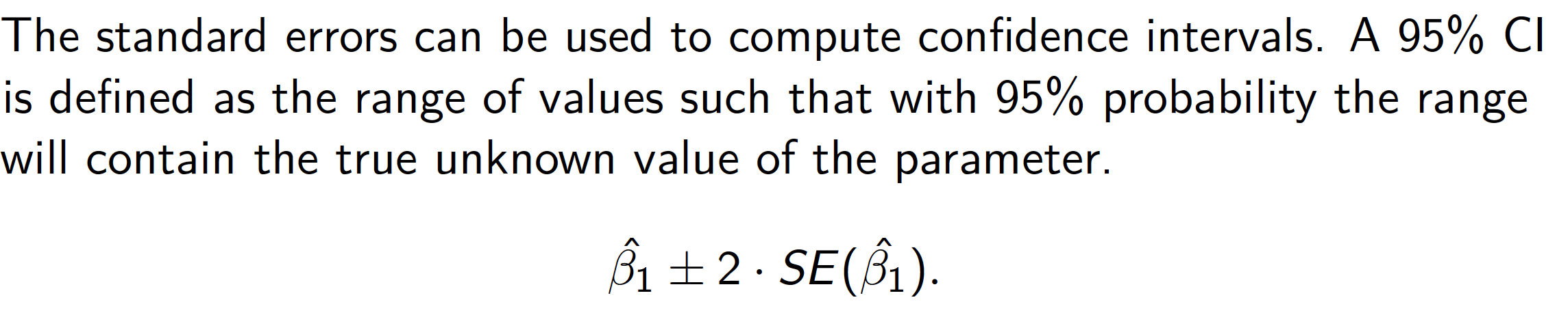
Linear regression. Standard errors

Slide 17
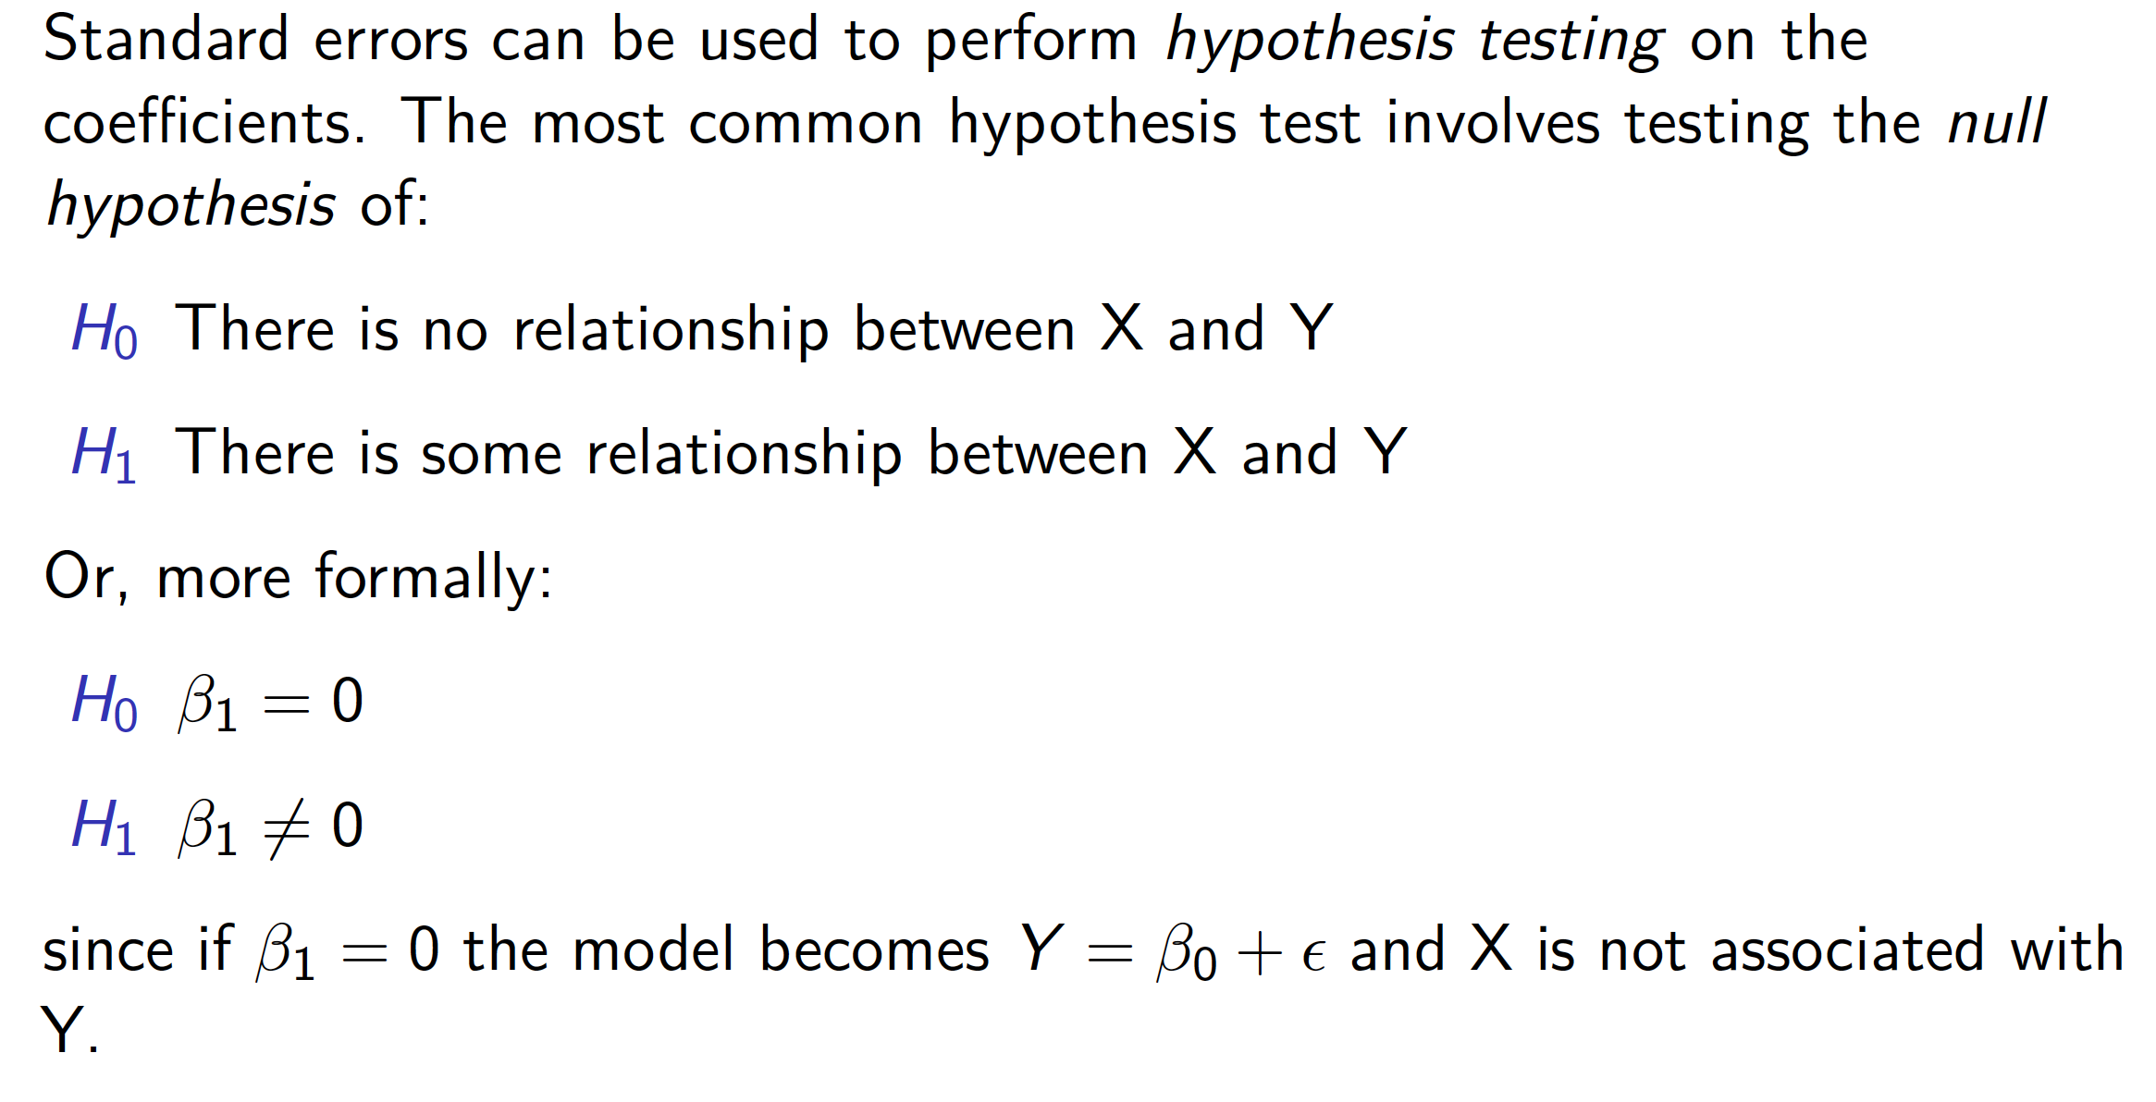
Linear regression. Hypothesis testing

Slide 18
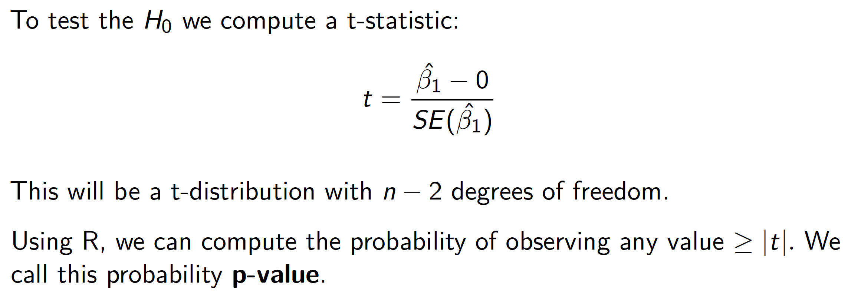
Linear regression. P values

Slide 19
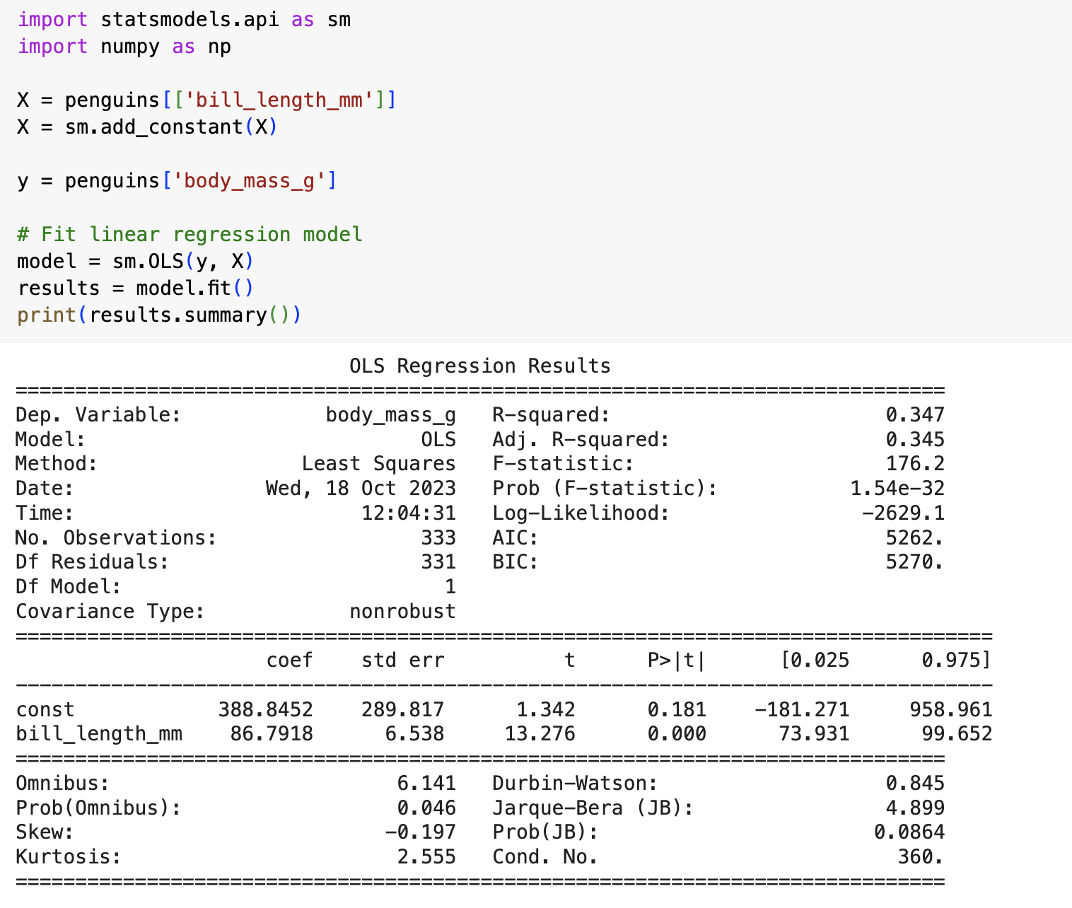
Linear regression

Slide 20
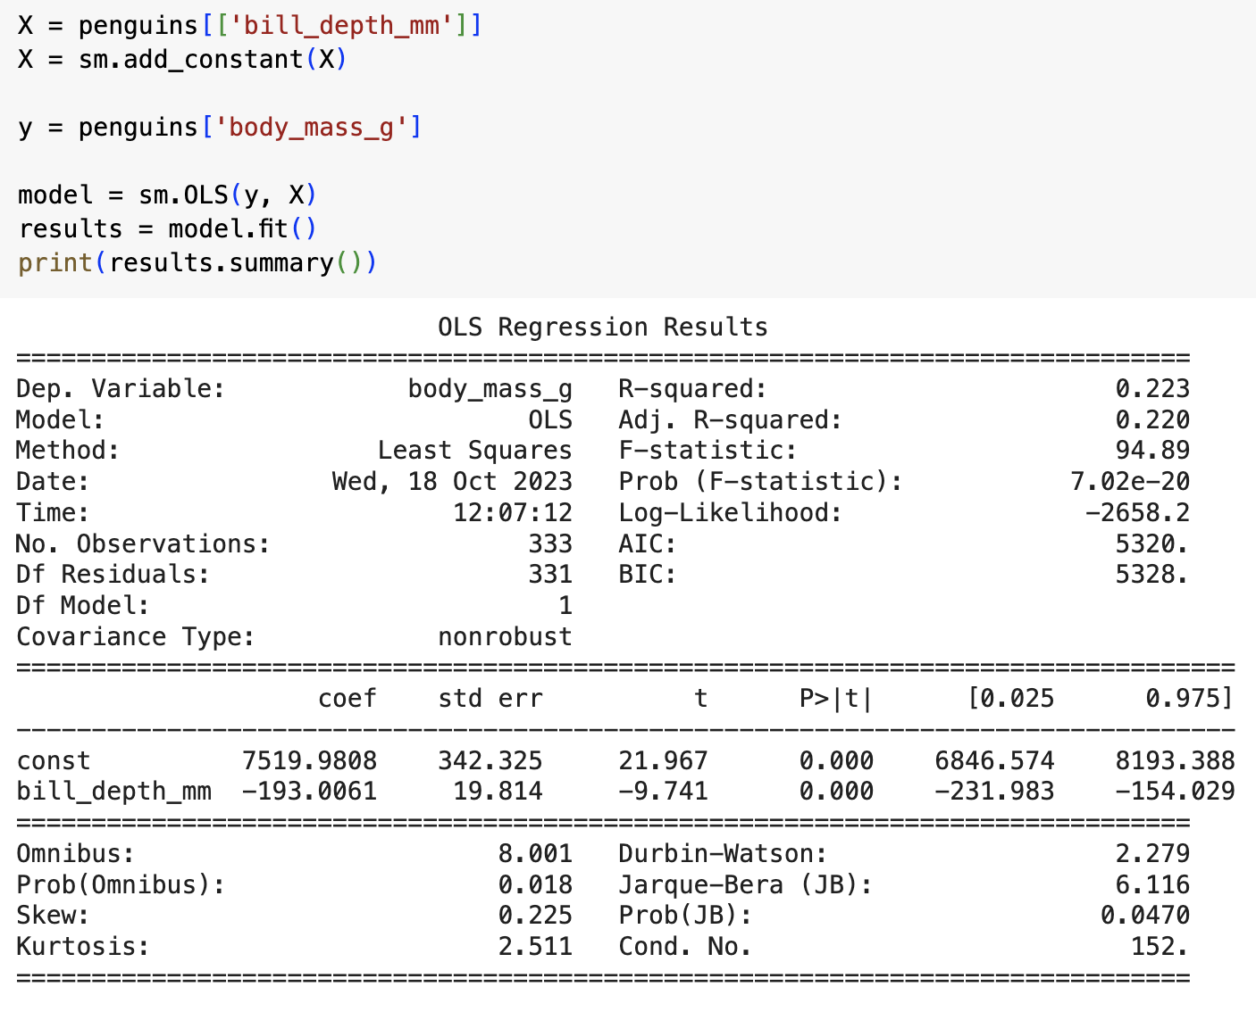
Linear regression

Slide 21
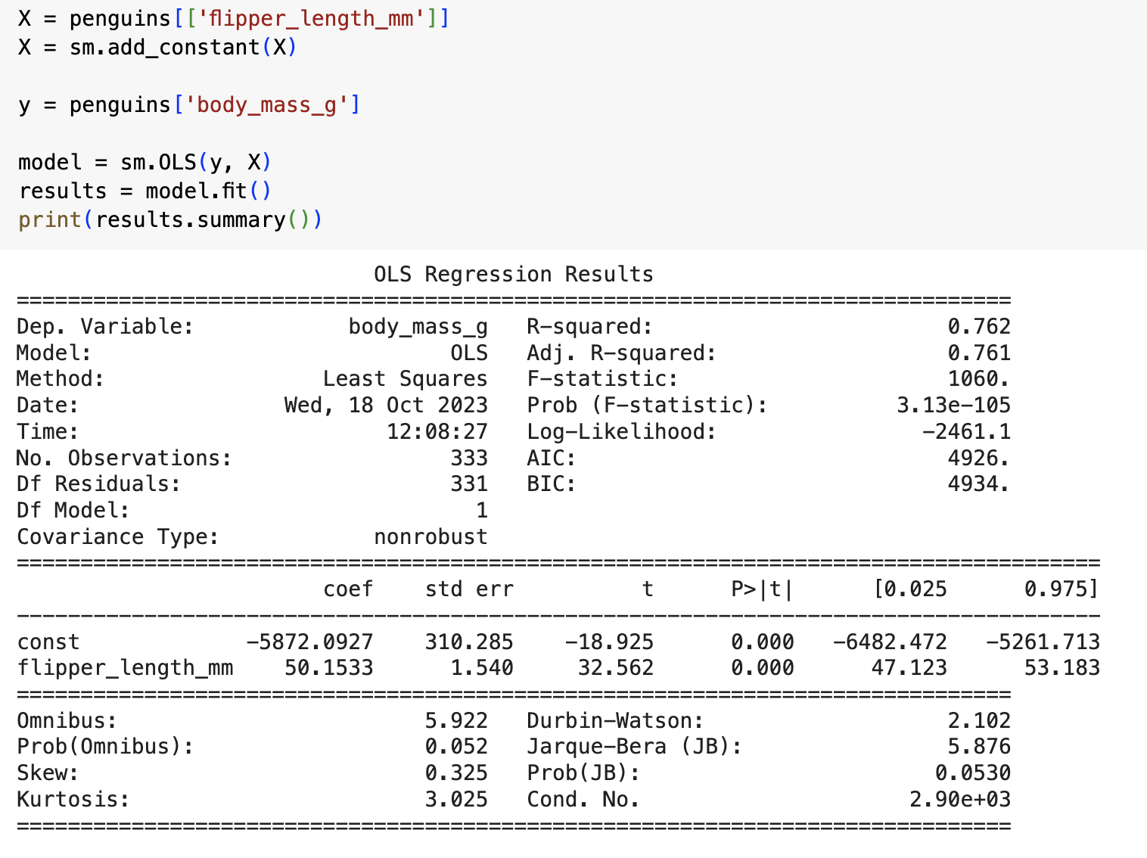
Linear regression

Slide 22
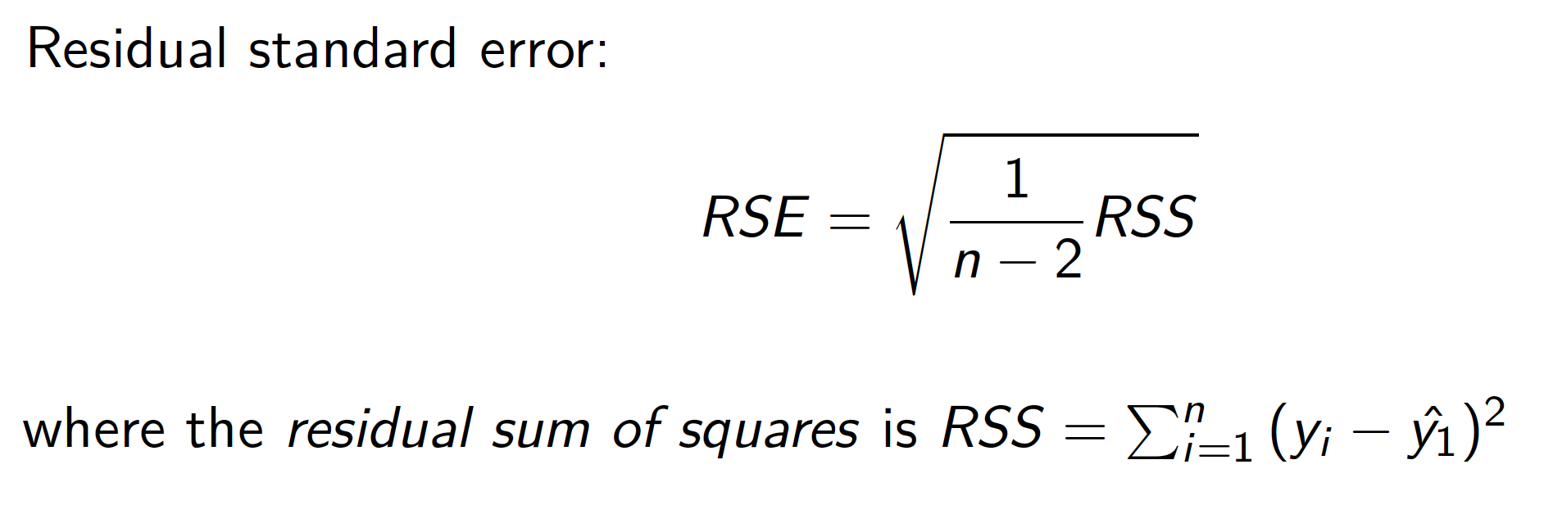
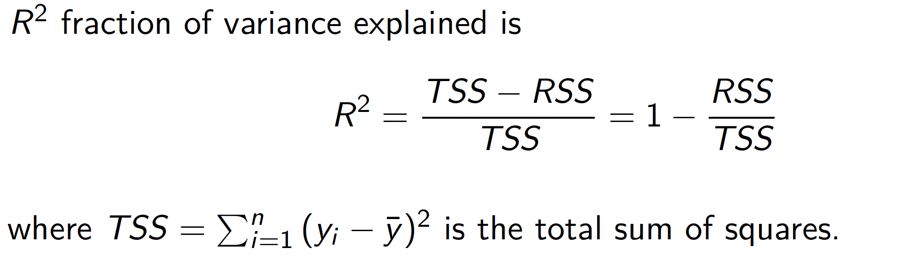
Linear regression. Assessing accuracy

Slide 23
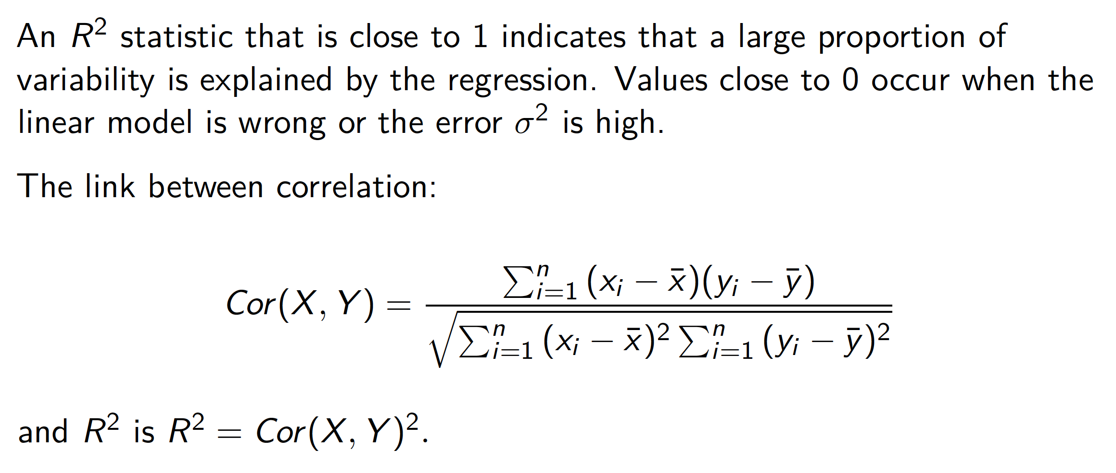
Linear regression. Assessing accuracy

Slide 24
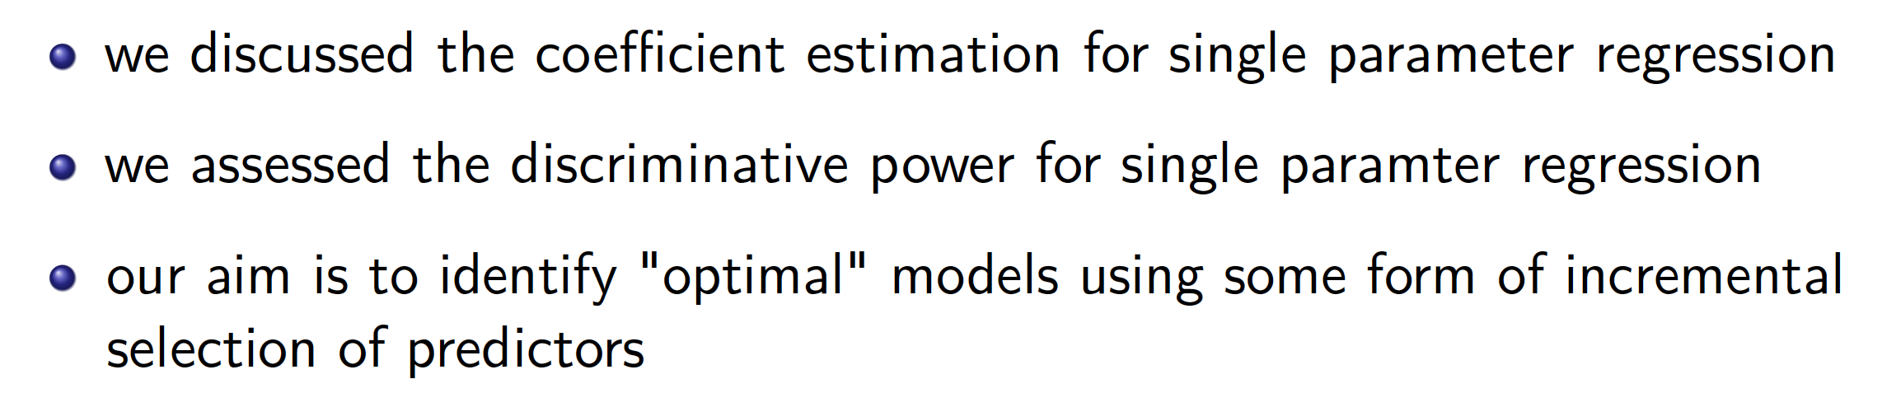
Linear regression. Main points

Slide 25
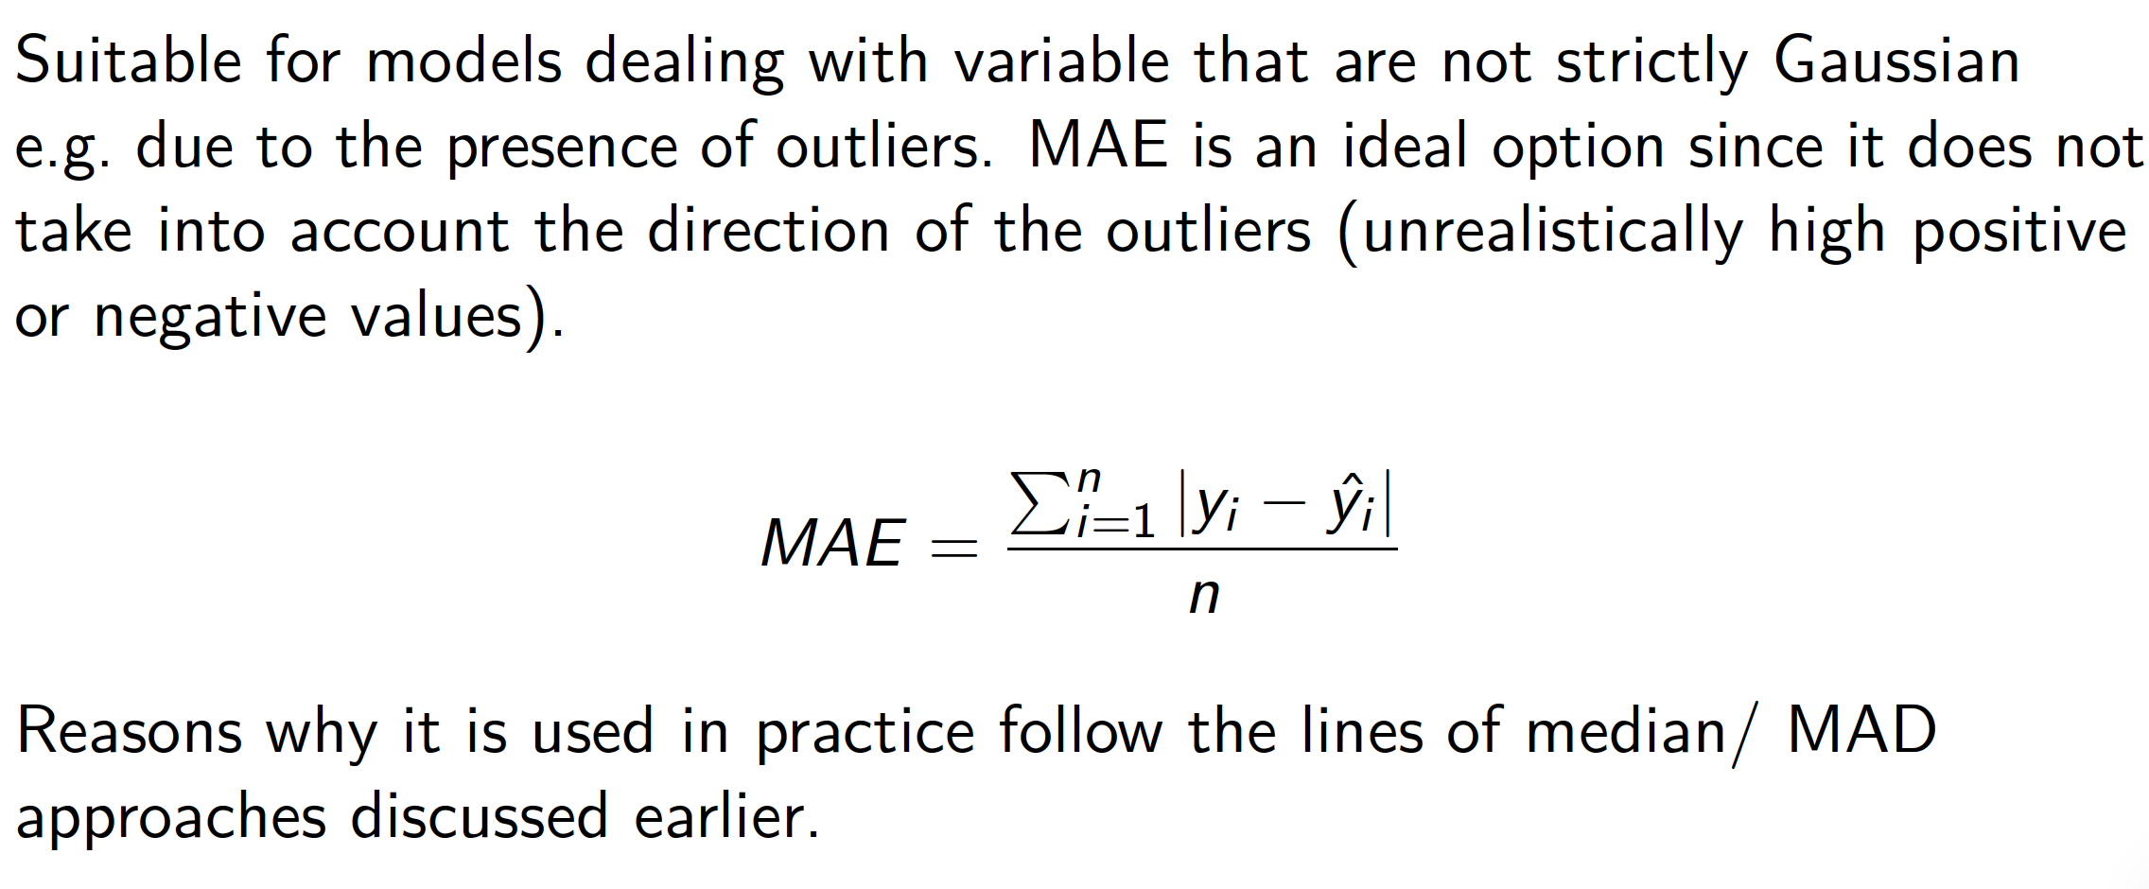
Linear regression. Other loss functions L1 loss function

Slide 26
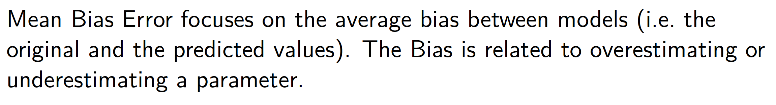
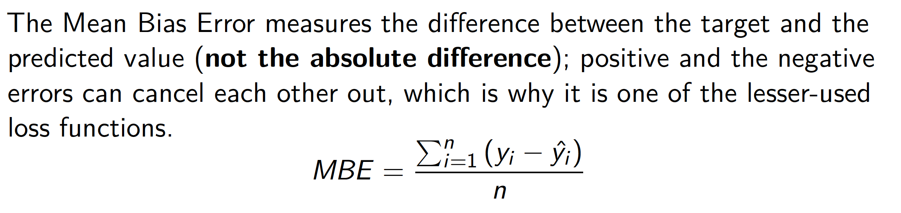
Linear regression Mean Bias Error

Slide 27
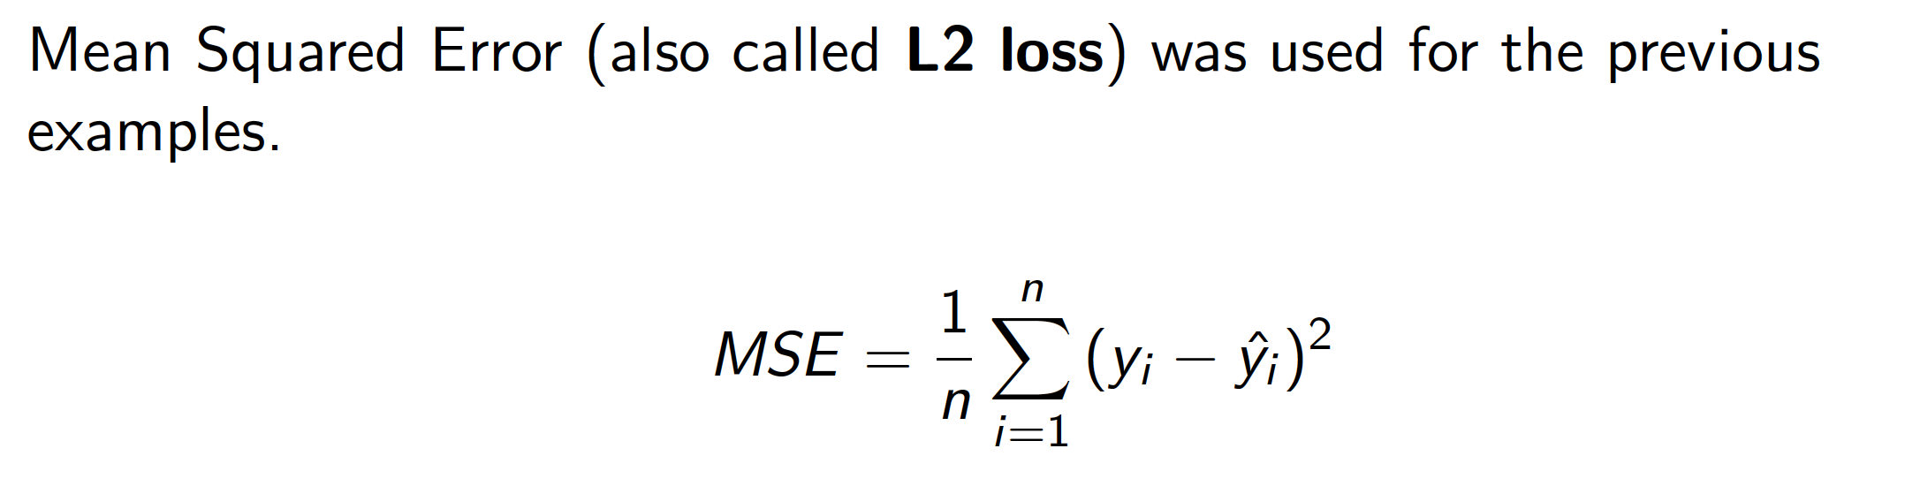
Linear regression. L2 loss

Slide 28
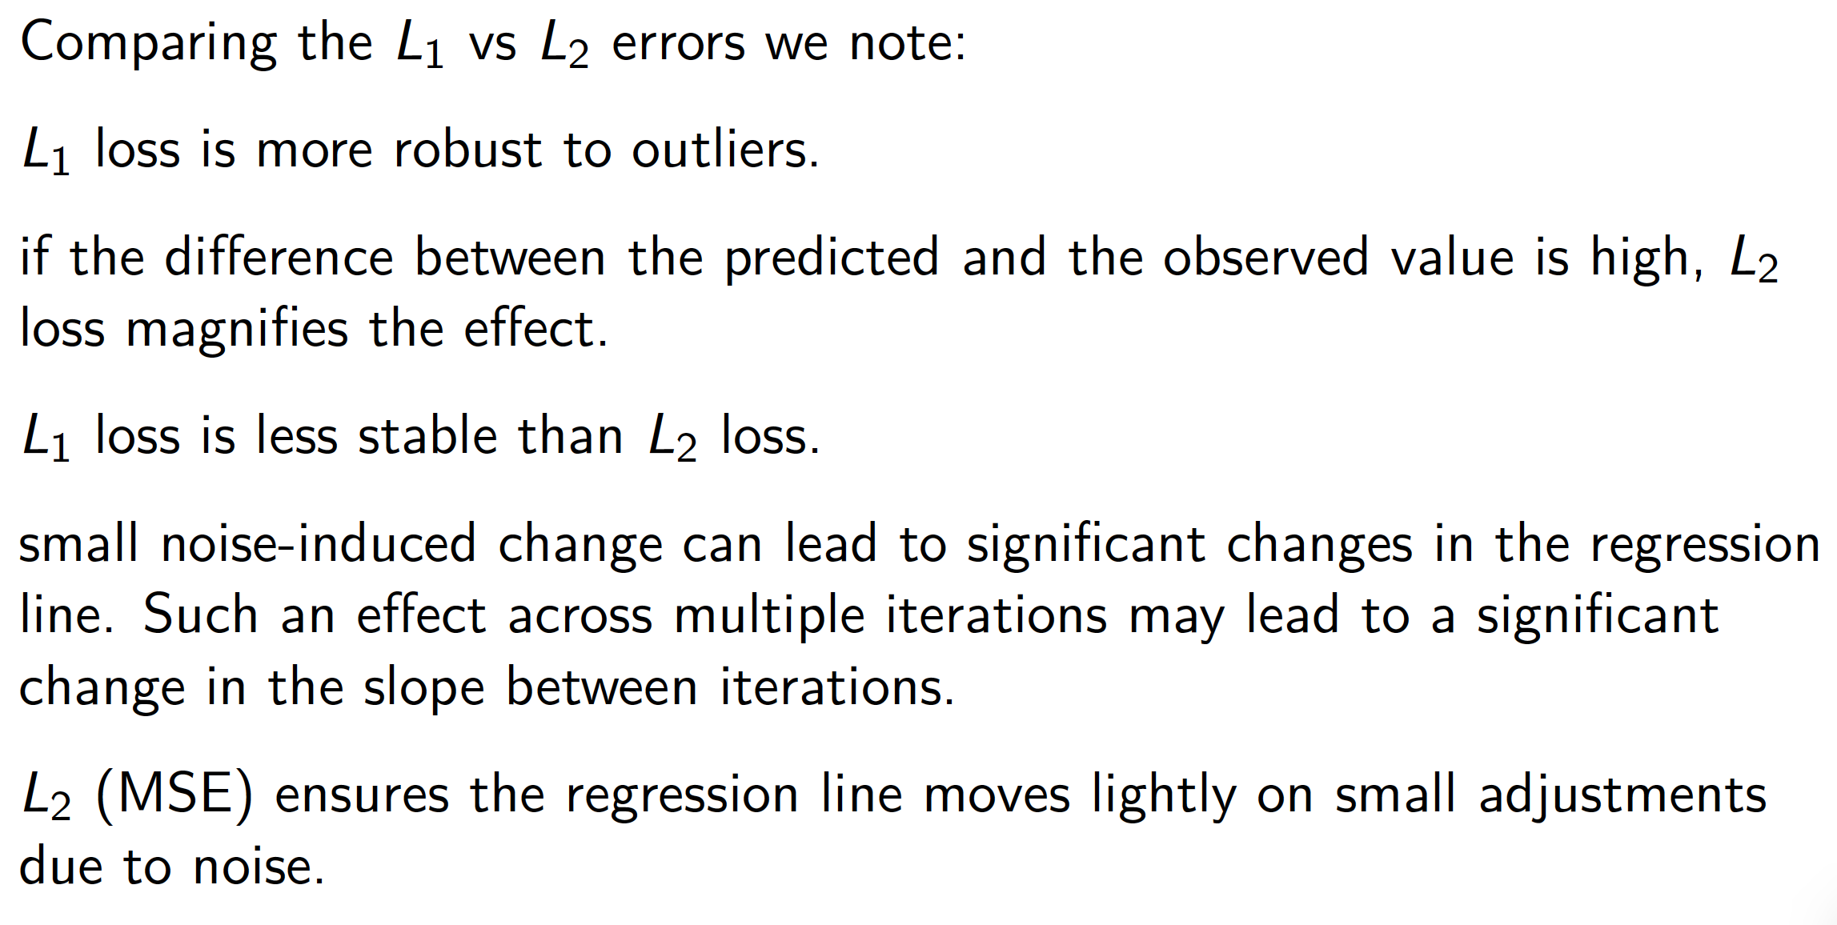
Linear regression. Loss functions

Slide 29
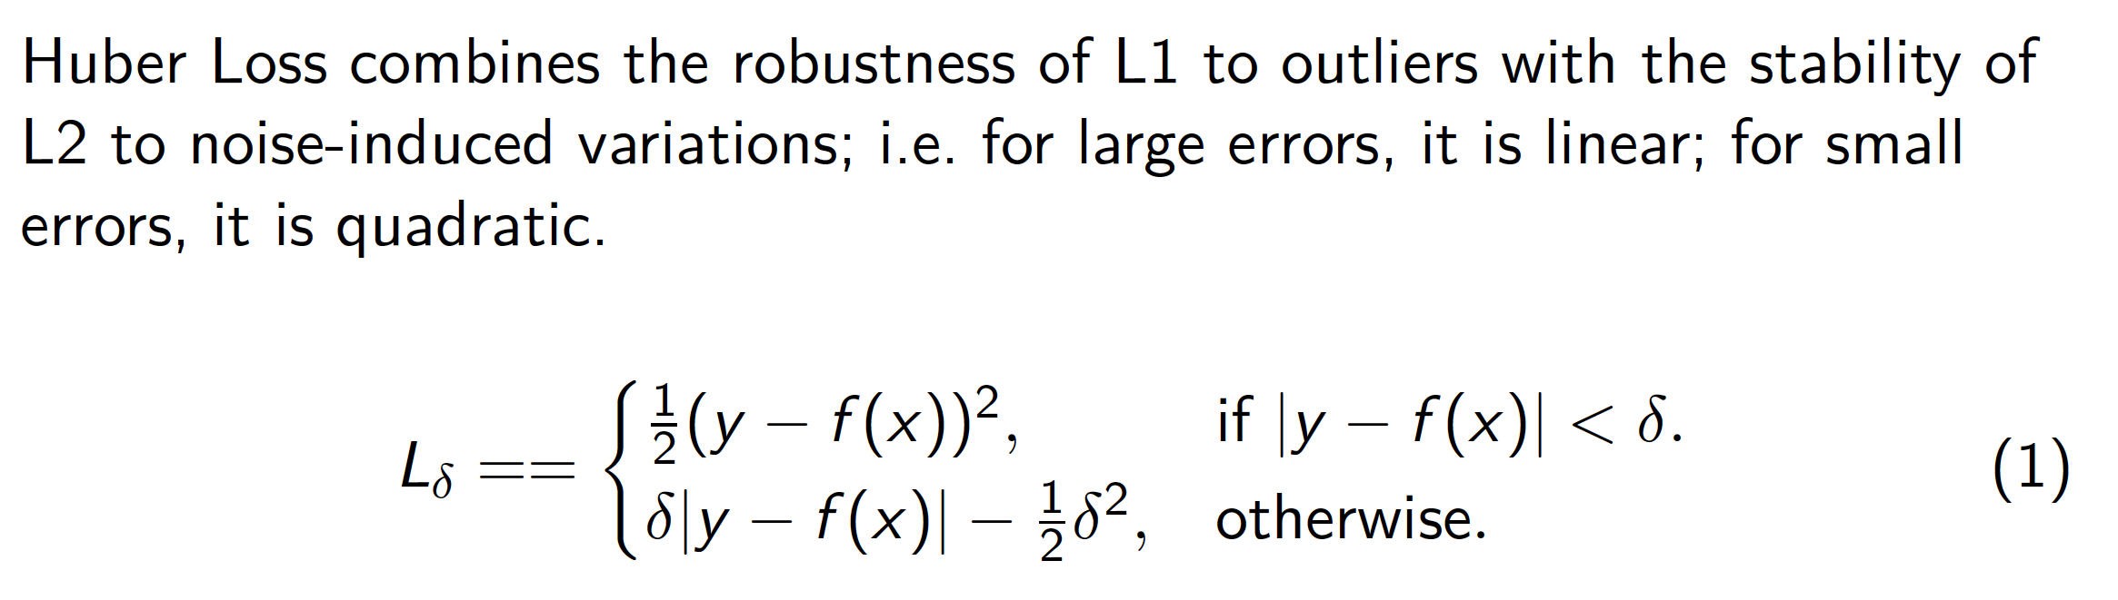
Linear regression Huber loss

Slide 30
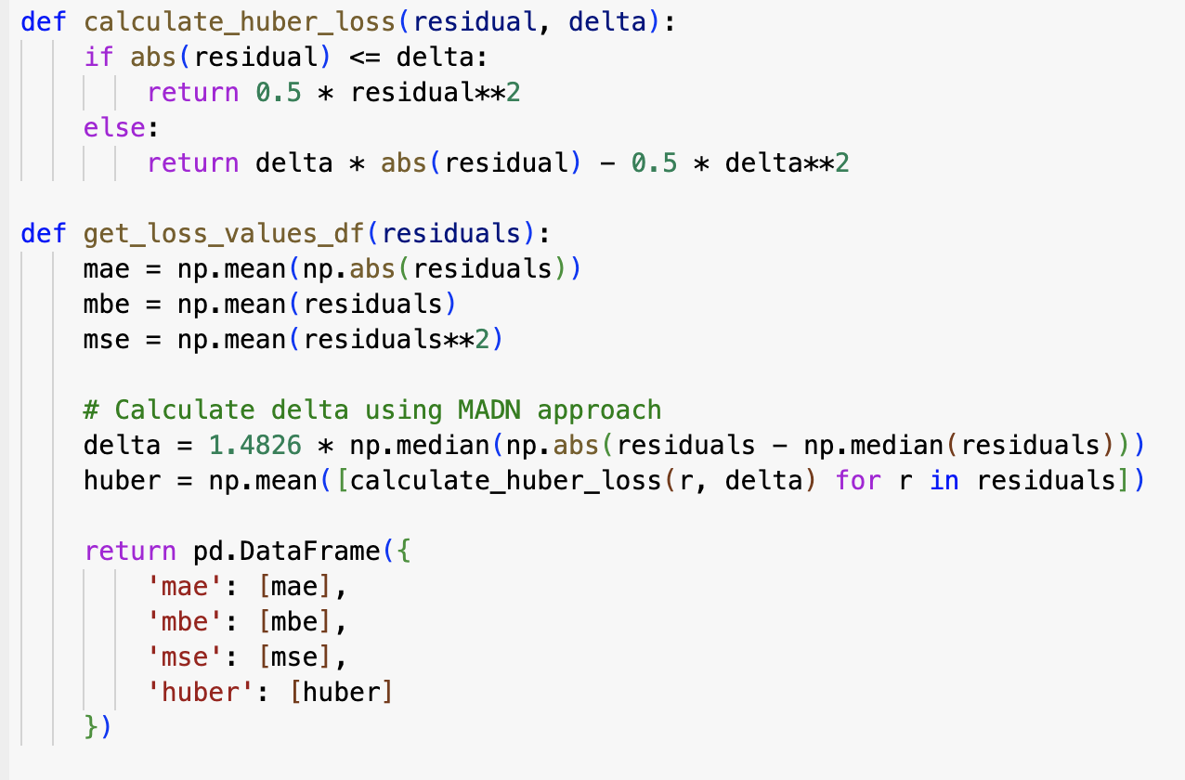
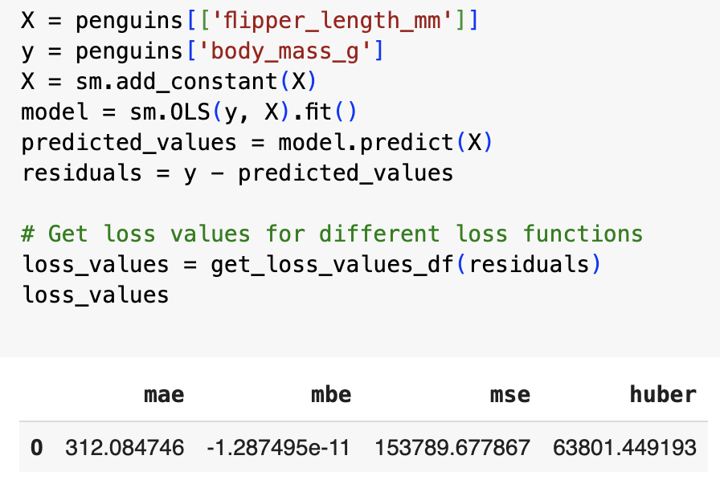
Linear regression Comparison of loss functions
MAE: on average, the predictions are off by 312 units.
MBE: the errors cancel out i.e the model doesn't have a systematic bias in its predictions; rephrased, it does not consistently overpredict or underpredict the target variable.
MSE: larger errors are amplified; highest value across metrics; even a few significant deviations (outliers) can result in a high value.
Huber loss bridges MAE and MSE, penalizing outliers on a linear function. Its value between MAE and MSE suggests there are outliers in the data.

Slide 31
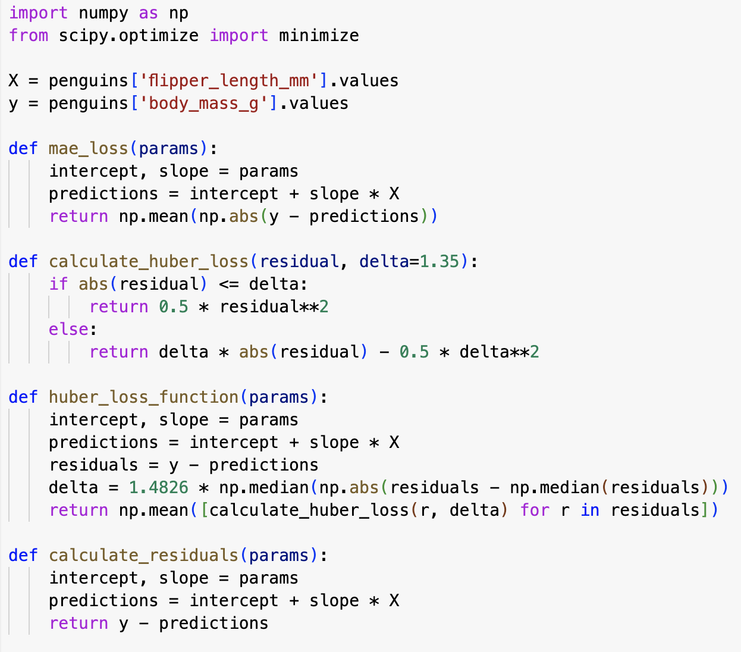
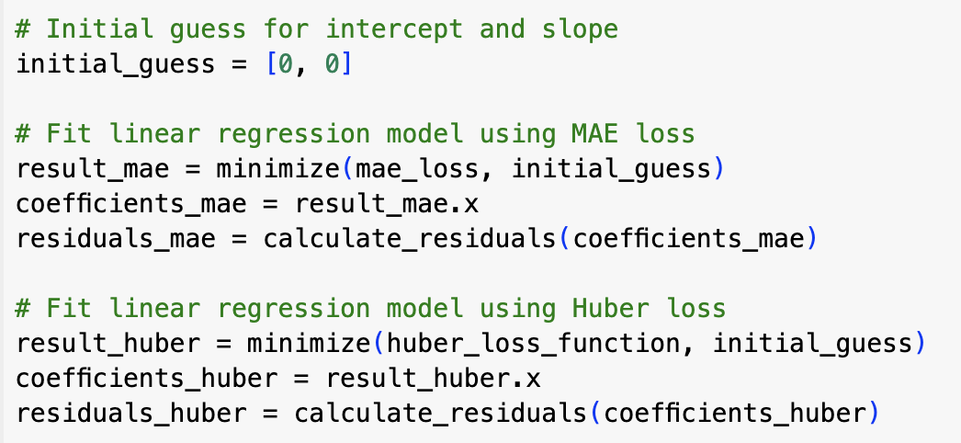
Linear regression. Comparison of loss functions
Fit linear regression models using different loss functions (MAE, MBE, Huber loss), calculating coefficients and residuals for each.

Slide 32
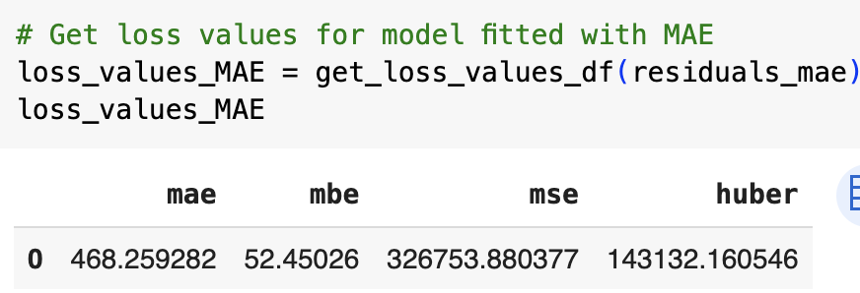
Linear regression. MAE loss
Optimized to minimize the average absolute error.
The MBE is positive, i.e. the model tends to underpredict the target variable, though the value is relatively small.
MSE and Huber loss values suggest some presence of outliers

Slide 33
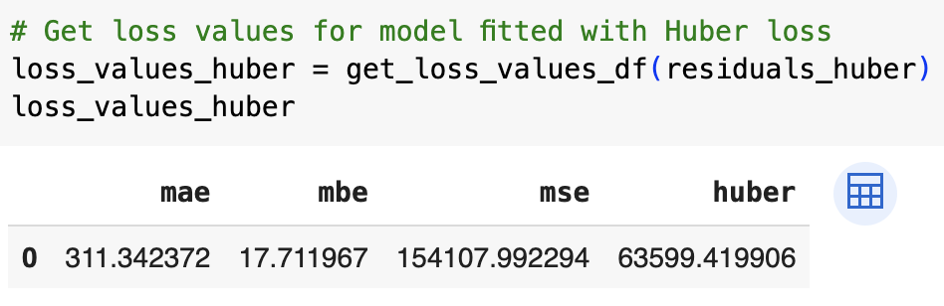
Linear regression. Huber loss
The Huber loss balances MAE (L1) and MSE (L2). It inherits the robustness of MAE against outliers, while also benefiting from the stability of MSE on small residuals.
The results of the Huber model are as expected a balance between the results of the MAE and MSE models.

Slide 34
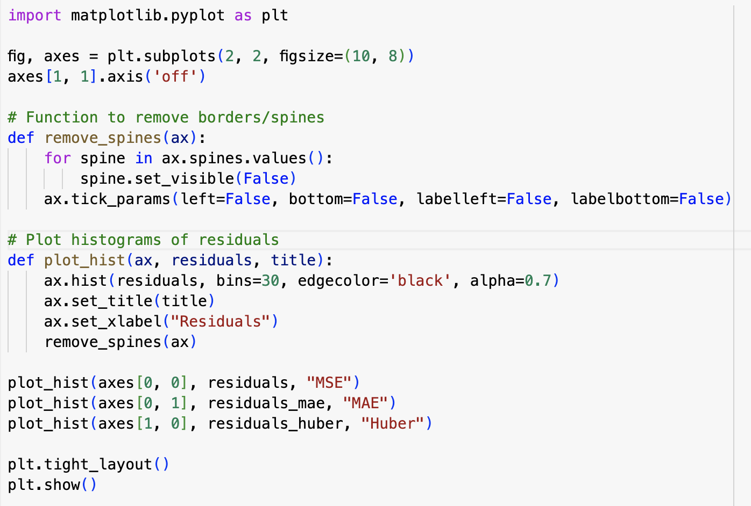
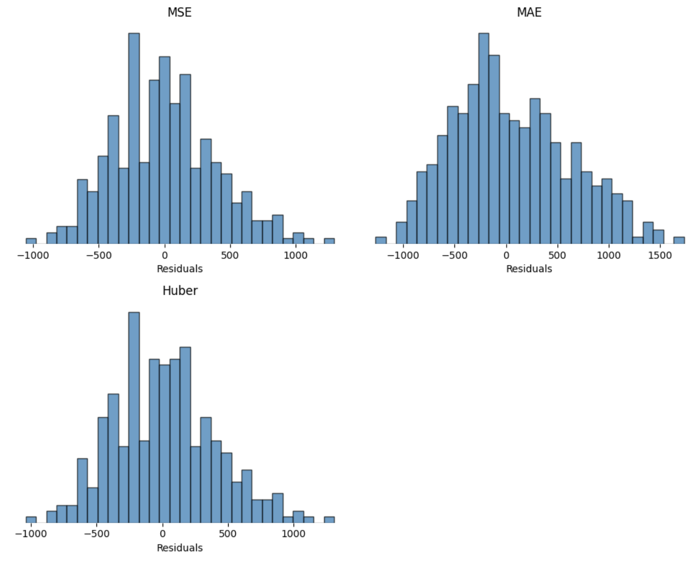
Linear regression. Comparison loss functions. Residuals

Slide 35
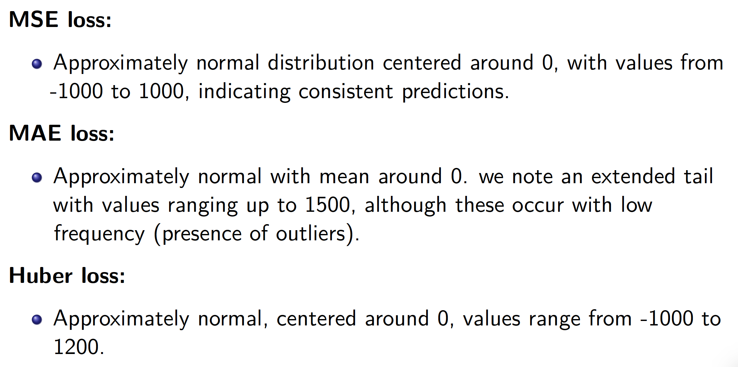
Linear regression. Comparison of loss functions

Slide 36
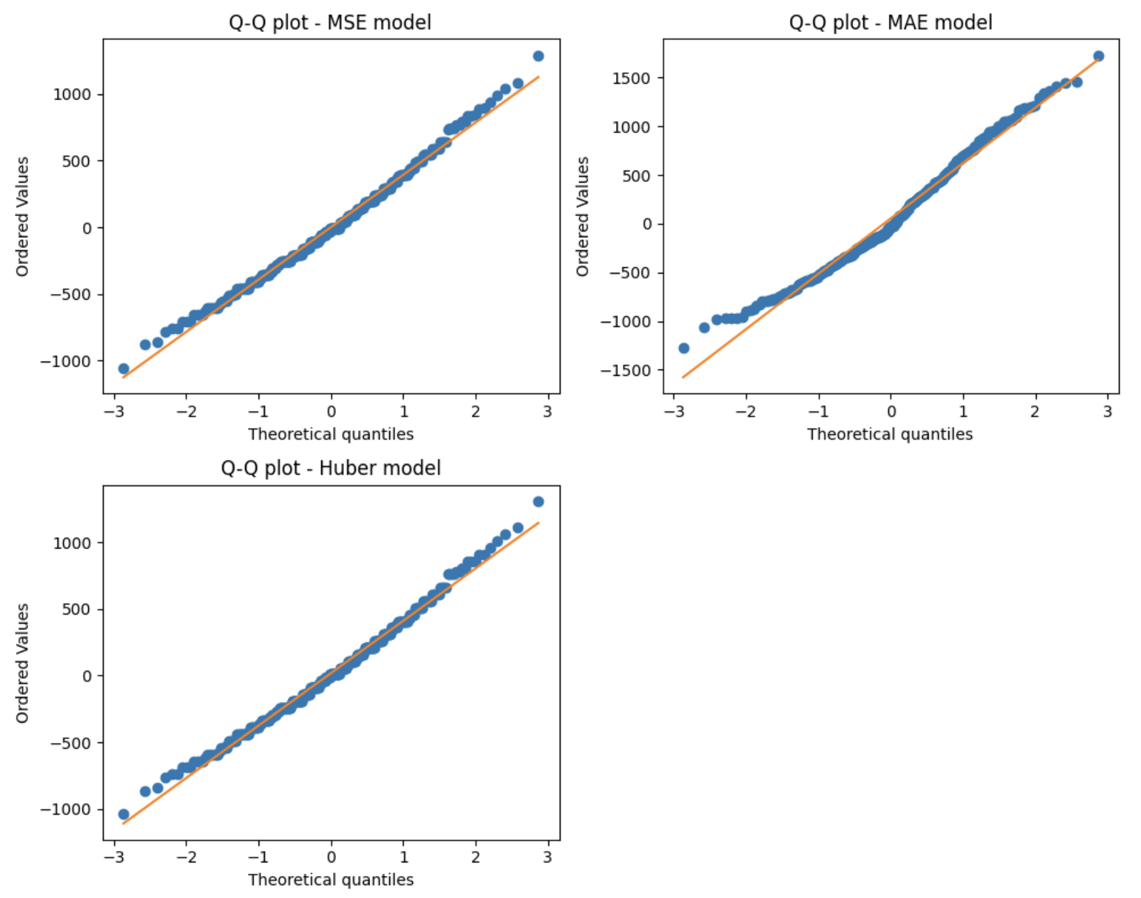
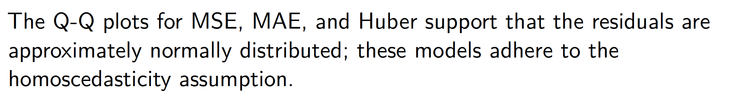
Linear regression. Homoscedasticity of residuals

Slide 37

Linear regression. Bias/Variance tradeoff

Slide 38

Linear regression. Bias/variance decomposition

Slide 39

Linear regression

Slide 40

Outline [Regression 2]

Slide 41

Linear regression. Multiple regression

Slide 42


Linear regression. Pre-processing tests

Slide 43

Linear regression Assessment of colinearity

Slide 44

Linear regression. Questions related to multiple predictors

Slide 45

Linear regression Important variables

Slide 46

Linear regression. Forward selection

Slide 47


Linear regression Forward selection

Slide 48

Linear regression Forward selection

Slide 49

Linear regression Forward selection
model.FL.BD.BL has a similar RSS compared to model.FL.BD, and comparable R^2 i.e. we are not explaining more signal.
We also note that the difference in R^2 between model.FL.BD and model.FL is minimal.
Following the lines of keep-it-simple, the preferred model is model.FL

Slide 50

Linear regression Backward selection

Slide 51

Linear regression Backward selection
The bill_length_mm has the largest p-value. i.e. it will be excluded

Slide 52

Linear regression Backward selection
The bill_depth_mm has the largest p-value. i.e. it will be excluded

Slide 53

Linear regression. Backward selection
The remaining feature is significant – this is the final model

Slide 54


Linear regression. Mixed selection

Slide 55


Linear regression. Models with categorical variables

Slide 56


Linear regression Models with categorical variables

Slide 57

Linear regression Models with categorical variables

Slide 58

Non-parametric models. Decision trees Brief contrast

Slide 59
Non-parametric models. Decision trees Brief contrast
Why do we like seed 42? https://medium.com/@leticia.b/the-story-of-seed-42-874953452b94

Slide 60


Non-parametric models. Decision trees Brief contrast

Slide 61


Non-parametric models. Decision trees Brief contrast

Slide 62


Non-parametric models. Decision trees Brief contrast

Slide 63

Non-parametric models. Decision trees Brief contrast

Slide 64


Non-parametric models. Decision trees Brief contrast

Slide 65

Non-parametric models. Decision trees Brief contrast

Slide 66

Linear regression
Performance analysis: The model achieved very high accuracy ~95%.
This performance is comparable to what we observed on
the validation set i.e. the model has high stability
and generalises well.
Adelie Penguins
Sensitivity: 96.55% of actual Adelie penguins were correctly identified.
Specificity: 93.33% of non-Adelie instances were correctly classified.
Misclassifications: Two Adelie penguins were predicted as Gentoo.
Chinstrap Penguins
Sensitivity: 100% of actual Chinstrap penguins were correctly identified.
Specificity: 93.33% of non-Chinstrap instances were correctly classified.
Gentoo Penguins
Sensitivity: 100% of actual Adelie penguins were correctly identified.
Specificity: 91.66% of non-Adelie instances were correctly classified.
Misclassifications: One Gentoo penguins was predicted as Chinstrap.

Slide 67



Linear regression. Regularisation

Slide 68

Linear regression. Ridge regularisation

Slide 69


Linear regression. Lasso regularisation

Slide 70
Wise advice from others …

Slide 71
Next Lecture …
Applied Data Science L8. Supervised learning. Classification

